Slide 1
Generations of Knowledge Graphs:
The Crazy Ideas and The Business Impact
Xin Luna Dong
3/2024
This talk does not represent the company’s point of view

Slide 2
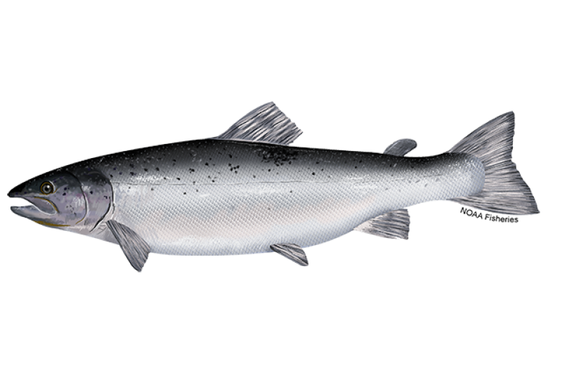
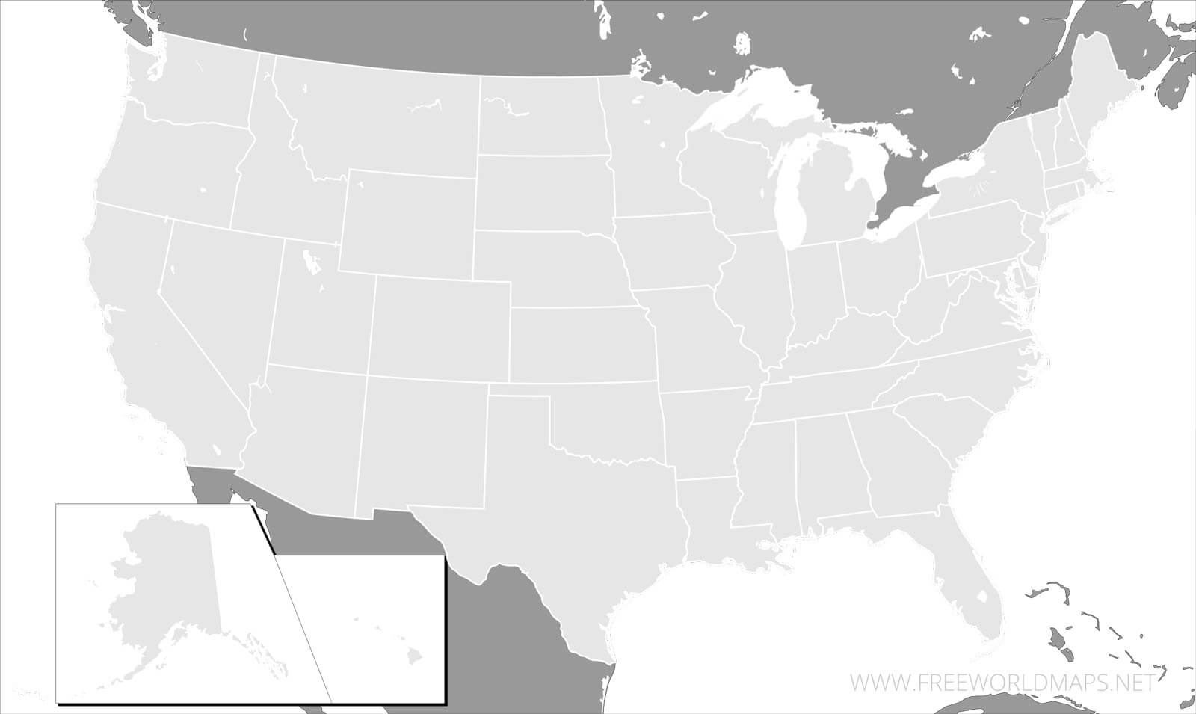
About Me (1): My Journey
Amazon
PhD @ UW
Meta
Pure researcher @ AT&T Labs
Intern
@ Google
Google

Slide 3
About Me (1): KGs in My Journey
Amazon Product KGs
Personal KGs
Google KGs

Slide 4
About Me (2): My Favorite Quote
Science is to test crazy ideas;
Engineering is to bring these ideas into business
— Andreas Holzinger

Slide 5
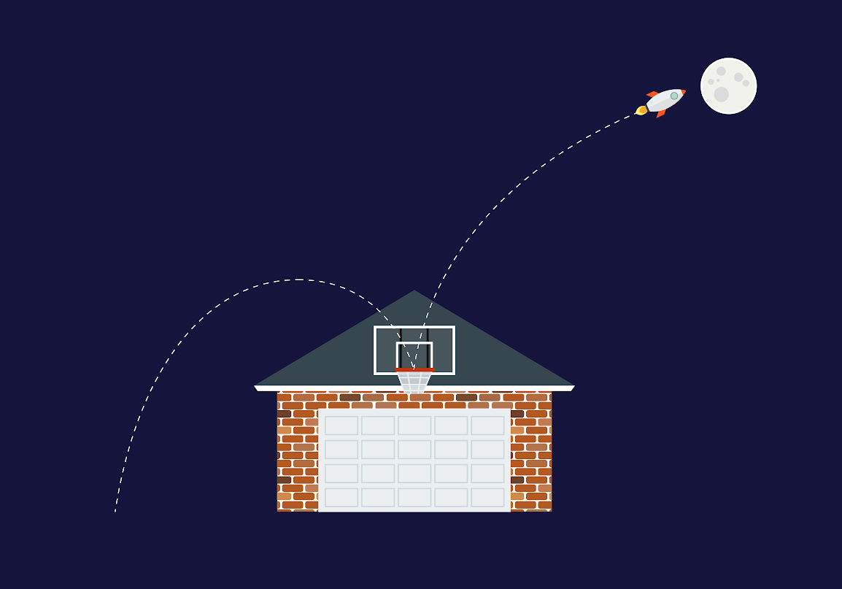
About Me (2): My Research Philosophy
Moonshots: Strive to apply and invent the state-of-the-art​
Roofshots: Deliver incrementally and make production impacts

Slide 6
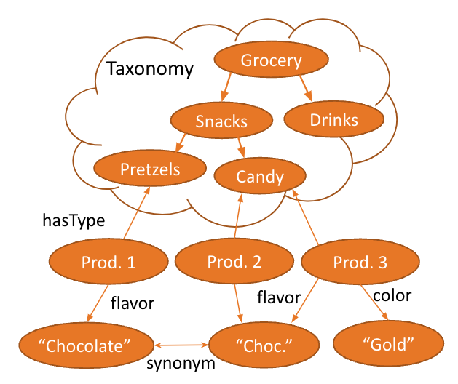
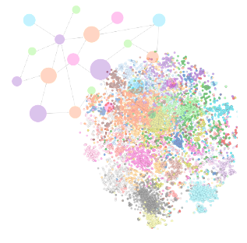
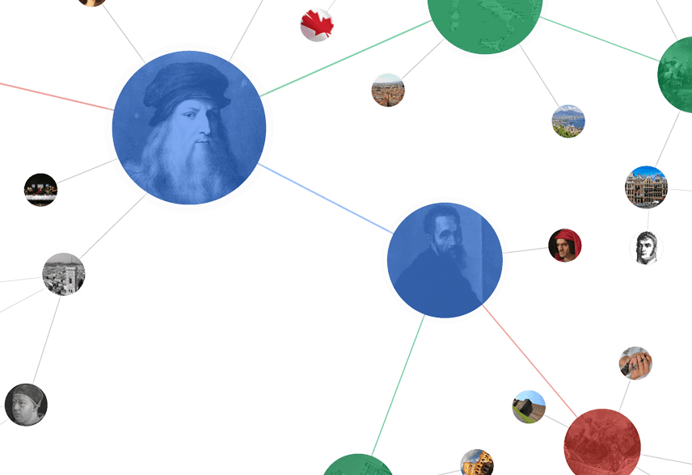
Theme I. Three Generations of Knowledge Graphs
1. Entity-Based KGs
2. Text-Rich KGs
3. Dual Neural KGs
Google Generic KGs
Amazon Product KGs

Slide 7
Theme II. The Recipe from Innovation to Practice
1
0
0
0
0
0
0
0
0
0
0
0
0
,
,
,
,
Feasibility
Quality
Repeatability
Scalability
Ubiquity
A prototype,
an experiment,
to show it is possible
Production quality,
E2E MVP experiences
E2E pipelines, automations to allow for extensions to more domains
Significant cost reduction for
scale ups
High coverage, long-tail use cases, assumption removal, to next cycle of inventions

Slide 8

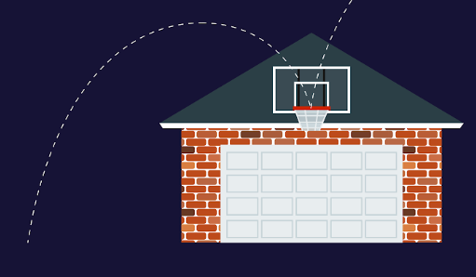

From Roofshots to Moonshots
1
0
0
0
0
0
0
0
0
0
0
0
0
,
,
,
,
Feasibility
Quality
Repeatability
Scalability
Ubiquity
Roofshots
Moonshots

Slide 9
Generation #1: Entity-Based Knowledge Graphs

Slide 10
Entity-Based KG Example
Entity
name
“Pop”
name
genre
mid127
“Dance-pop”
name
mid345
name
“Taylor Alison Swift”
“Shake it off”
artist
name
“Taylor Swift”
Song
type
artist
mid128
type
song_writer
birth_date
12/13/1989
“Love Story”
mid346
name
name
genre
mid129
“Country pop”
Entity type
Relationship
type
Genre
Notes:
Entity ID

Slide 11
Entity-Based KGs
Characteristics of Entity-Based KGs
Ontology (types, relationships) manually defined w. clear semantics
Entities are named-entities, w. no overlap
Crazy Idea
Create a graph of entities and relationships to represent the world

Slide 12
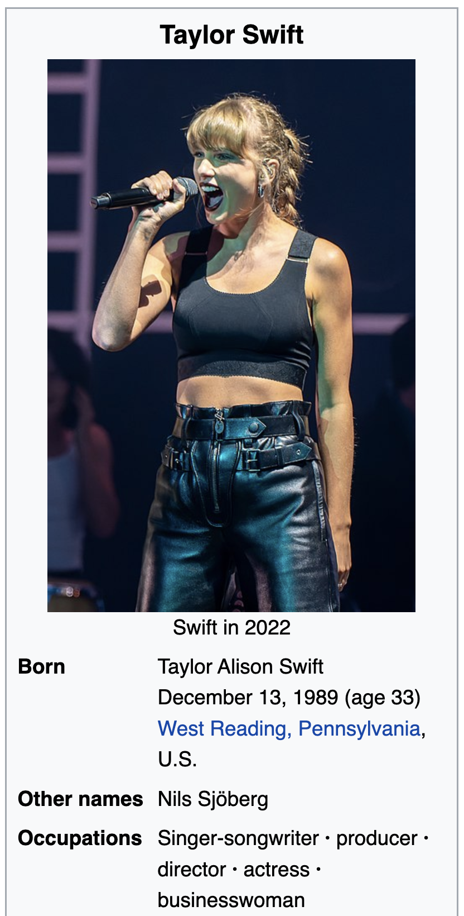
Transforming Wikipedia to A Knowledge Graph
First pot of gold: Transform Wikipedia Infoboxes to knowledge entities and relationships
1
Feasibility
A prototype,
an experiment,
to show it is possible
name
“Taylor Alison Swift”
name
“Taylor Swift”
mid128
birth_date
12/13/1989

Slide 13
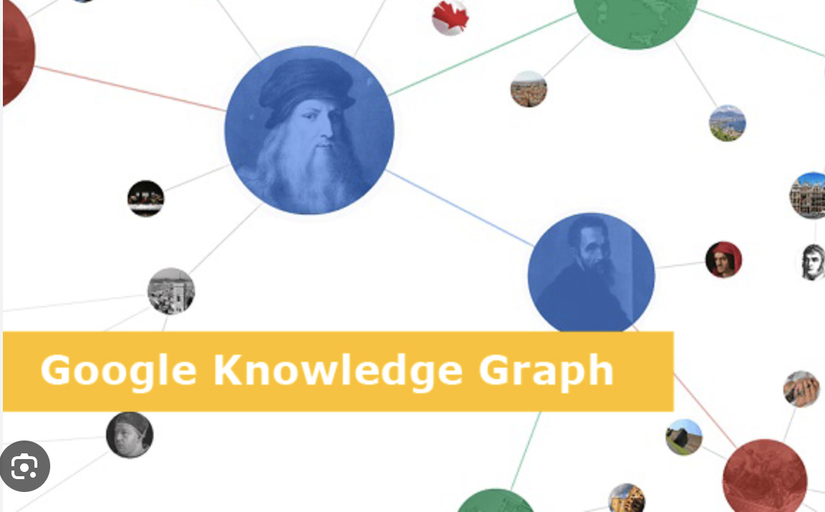




Transforming Wikipedia to A Knowledge Graph
High quality of Wikipedia data guarantees production quality. Common practice in industry.
Well-known examples
1K
Quality
Production quality,
E2E MVP experiences
Fabian M. Suchanek, Gjergji Kasneci, Gerhard Weikum. Yago: A core of semantic knowledge. WWW, 2007.

Slide 14

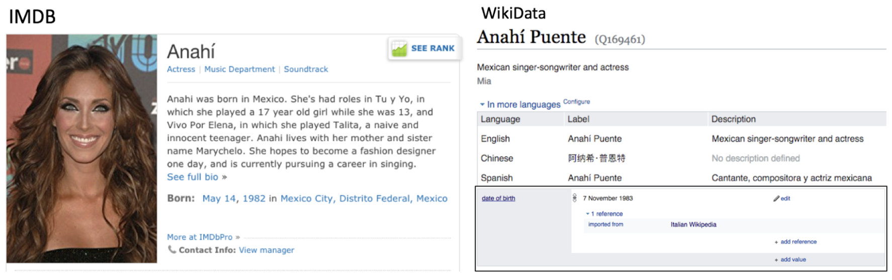
Integrating Data from Different Sources
1M
Repeatability
E2E pipelines, automations to allow for extensions to more domains
Are they the same person? → Entity Linkage
Are “Born” and “date of birth” the same? → Schema Alignment
Why “May 14, 1982” vs “7 November 1983”? → Data Fusion
Challenges: Heterogeneity, Heterogeneity, Heterogeneity
Solution: Data Integration
Xin Luna Dong, Divesh Srivastava. Big Data Integration. Morgan Claypool Publishers. 2015.

Slide 15
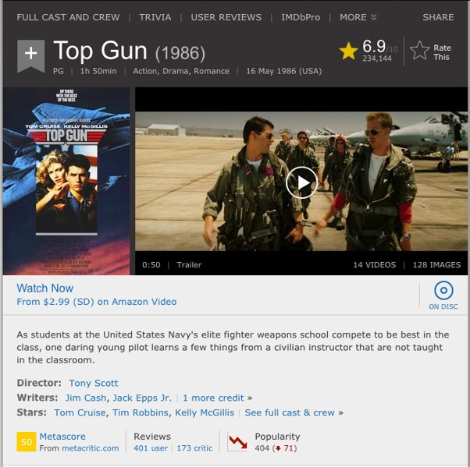
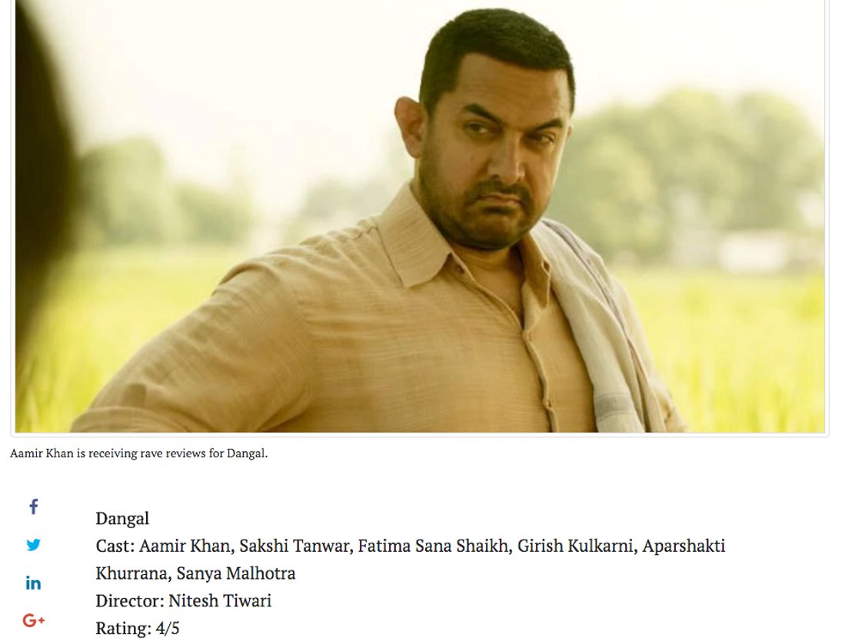
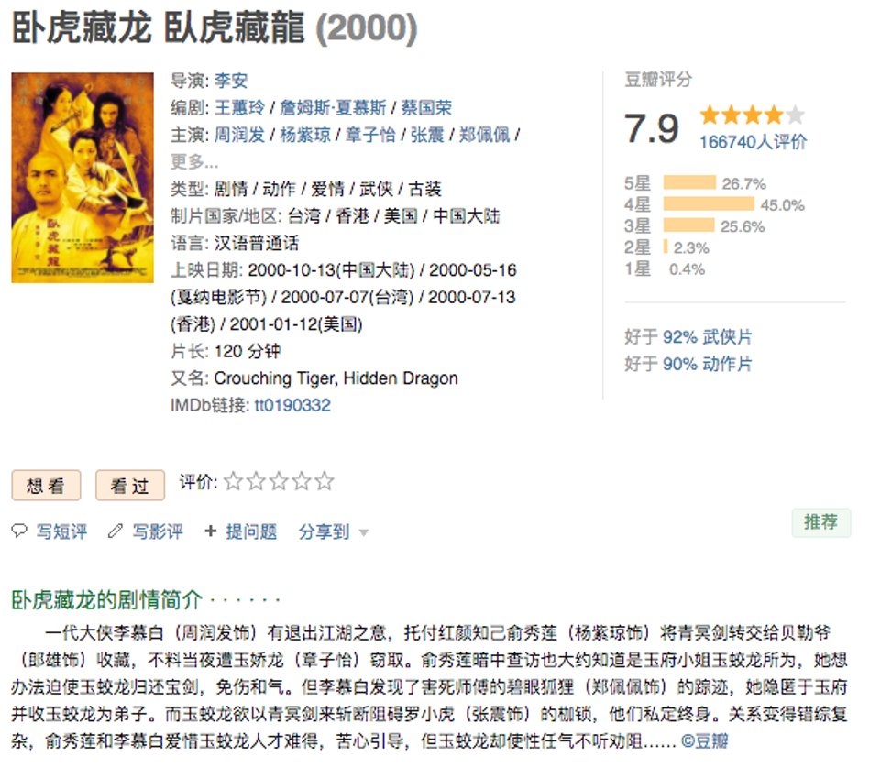
Extracting Data from Semi-Structured Websites
1B
Scalability
Significant cost reduction for
scale ups
Solution: Knowledge extraction
w. distant supervision & GNN
Lockard et al., Ceres: Distantly supervised relation extraction from the semi-structured web. VLDB, 2018.​

Slide 16
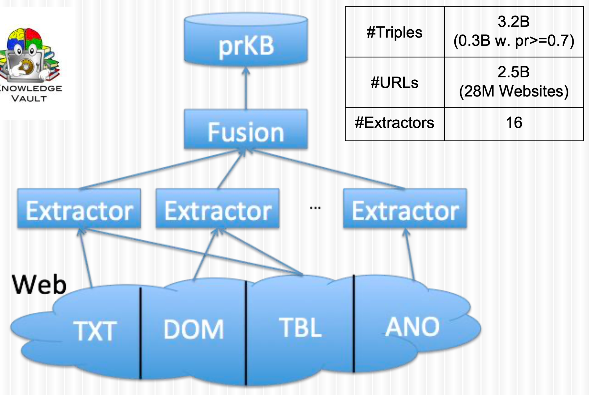
Web Knowledge Extractions & Fusion
1T
Ubiquity
High coverage, long-tail use cases, assumption removal, to next cycle of inventions
Solution: Web-scale extraction; knowledge fusion
Dong et al., From data fusion to knowledge fusion. PVLDB, 2014.
Dong et al., Knowledge Vault: A Web-scale approach to probabilistic knowledge fusion. SIGKDD, 2014.
Dong et al., Knowledge-based trust: Estimating the trustworthiness of web sources. PVLDB, 2015.

Slide 17
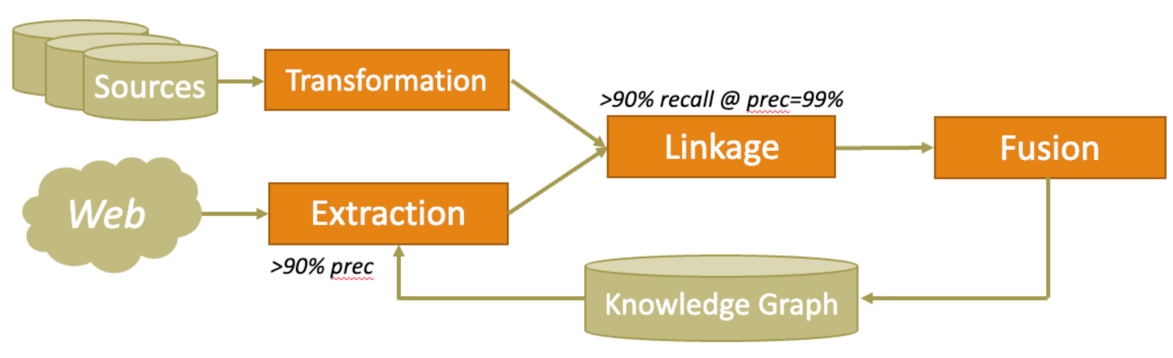

Entity-Based KG Summary
Crazy idea: A graph of entities and relationships to represent the world
Main challenges: Heterogeneous data everywhere
Framework:
Applications: Web search, Web Q&A, Smart assistant

Slide 18
What About the Product Domain?
1T
Ubiquity
Can we do the same for products?
High coverage, long-tail use cases, assumption removal, to next cycle of inventions

Slide 19
Generation #2: Text-Rich Knowledge Graphs

Slide 20
Text-Rich KG Example
Taxonomy
Other domains: Bioinformatics, Health, Geography, Local business, Events, etc.

Slide 21
Text-Rich KGs
Characteristics of Text-Rich KGs
Ontology (types, relationships) very complex with overlaps and ambiguities; E.g., millions of product types
Attribute values are oftentimes texts, with overlaps and ambiguities
E.g., “Coffee” vs “Cappuccino” as icecream flavors
Entities may not be named-entities, such as products
E.g., “Onus 2 Colors Highlighter Stick, Shimmer Cream Powder Waterproof Light Face Cosmetics, creamy Self Sharpening Crayon STick Highlighter” vs. “Xin Luna Dong”
Seed Crazy Idea
Mining structure and modeling ambiguity from text sources

Slide 22

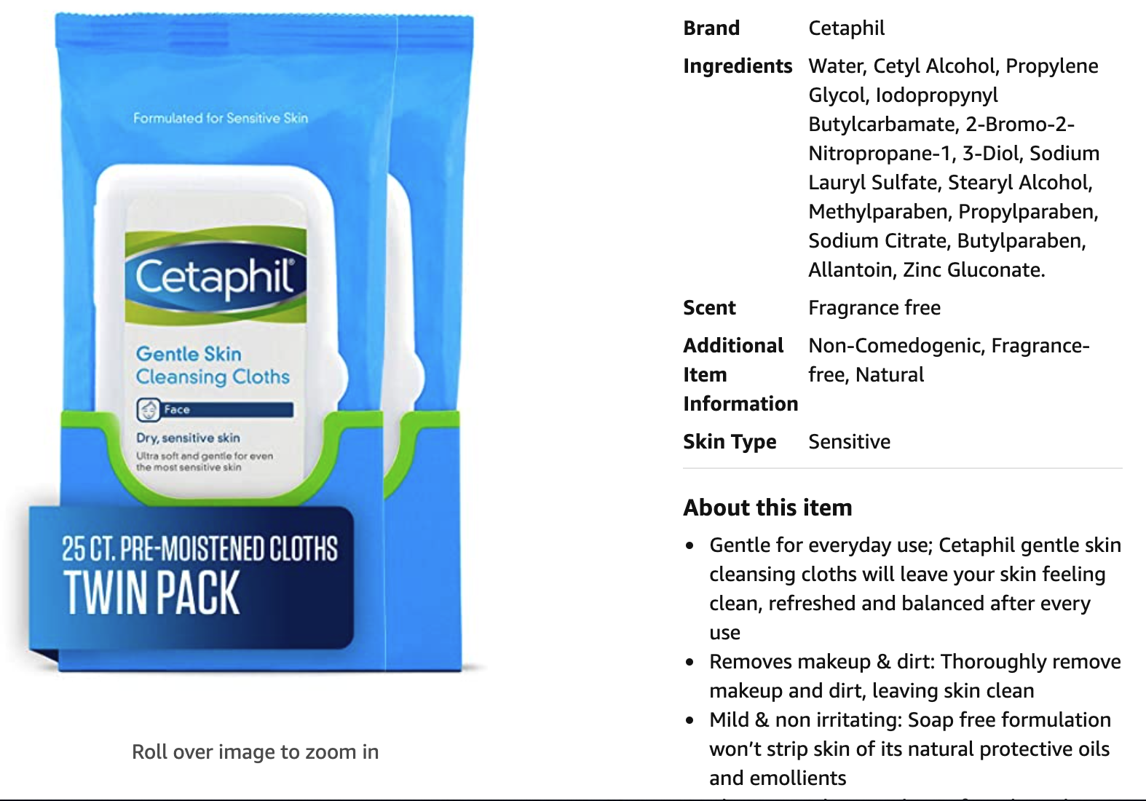
Use Case I: Providing Information

Slide 23
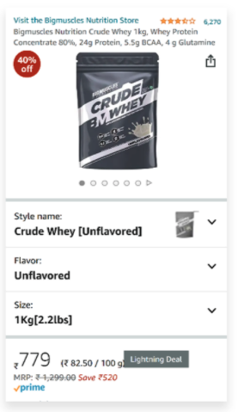
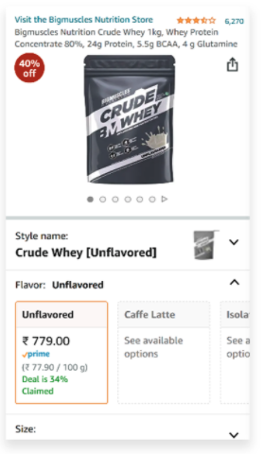
Use Case II: Providing Choices

Slide 24
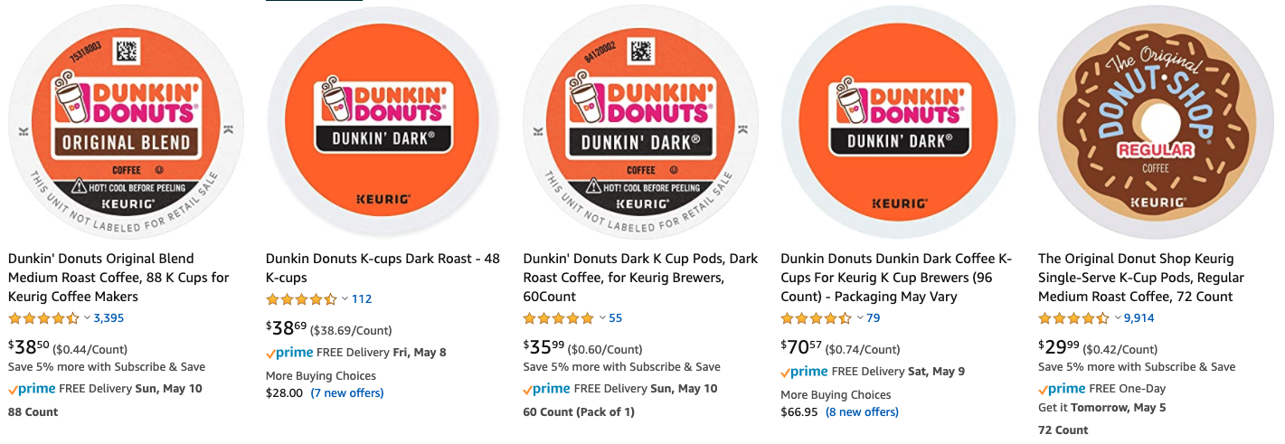
Use Case III: Improving Search

Slide 25
Use Case III: Improving Search

Slide 26
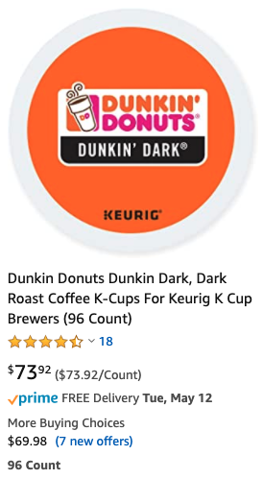
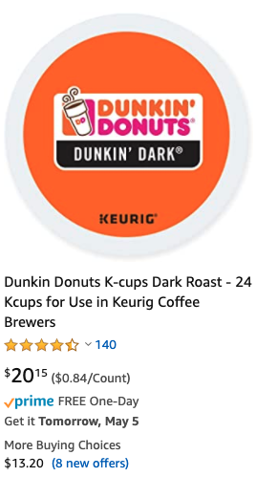
Use Case III: Improving Search

Slide 27
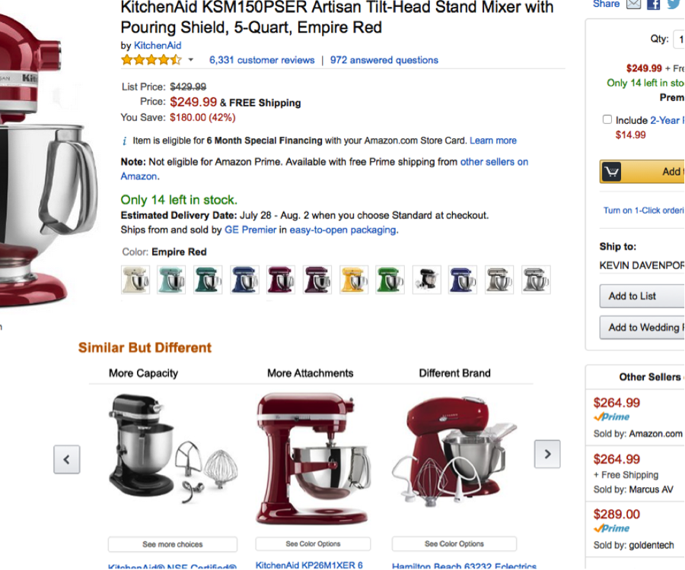
Use Case IV: Improving Recommendation

Slide 28
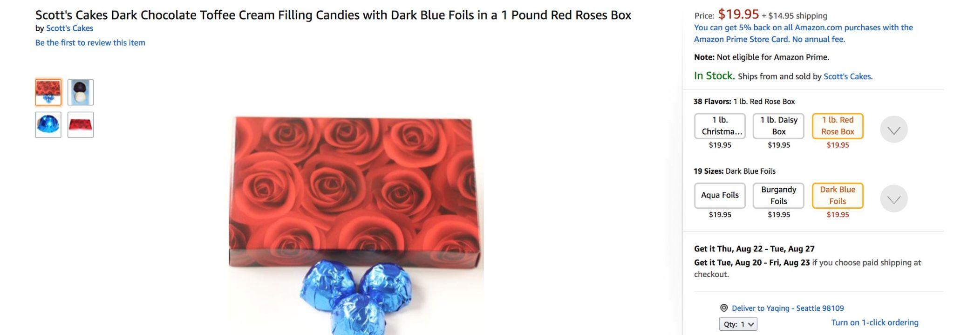
Do We Need Different Techniques?
Different challenges: Unstructured and Noisy product data

Slide 29
AutoKnow: Self-Driving Product Knowledge Collection
Taxonomy
Product KG
Grocery
Grocery
Snacks
Drinks
Snacks
Drinks
Candy
User logs
Pretzels
Candy
AutoKnow
Catalog
hasType
Product | Type | Flavor | Color
Product 1 | Snacks | Cherry
Product 2 | Candy | ? | ?
Product 3 | Candy | Choc. | Gold
Prod. 1
Prod. 2
Prod. 3
flavor
flavor
color
Chocolate
Choc
Gold
synonym
Dong et al., AutoKnow: Self-driving knowledge collection for products of thousands of types, SigKDD, 2020.

Slide 30
AutoKnow: Self-Driving Product Knowledge Collection
Taxonomy
Product KG
Grocery
Grocery
Snacks
Drinks
New Type
Snacks
Drinks
Candy
User logs
Pretzels
Candy
AutoKnow
Catalog
hasType
Product | Type | Flavor | Color
Product 1 | Snacks | Cherry
Product 2 | Candy | ? | ?
Product 3 | Candy | Choc. | Gold
Prod. 1
Prod. 2
Prod. 3
Corrected Value
flavor
flavor
color
Chocolate
Choc
Gold
synonym
New Value
Dong et al., AutoKnow: Self-driving knowledge collection for products of thousands of types, SigKDD, 2020.

Slide 31
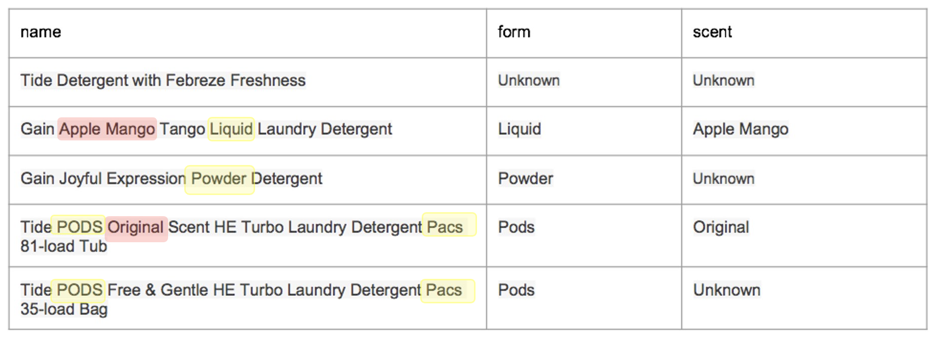
Extracting Product Attribute Values
1
Feasibility
A prototype,
an experiment,
to show it is possible

Slide 32



Building a Product Knowledge Extraction Pipeline
1K
Train and fine-tune models
Quality
OpenTag
Production quality,
E2E MVP experiences
Understand domain and attributes, and generate LOTS OF training data
Postprocess extraction results to further improve data quality
Pre-publish evaluation as gatekeeper to guarantee high quality data
Quality goal: 90% accuracy for product attributes
Solution: Pre-/Post-Processing

Slide 33
Building a Product Knowledge Extraction Pipeline
1M
Train and fine-tune models
Repeatability
OpenTag
E2E pipelines, automations to allow for extensions to more domains
Understand domain and attributes, and generate LOTS OF training data
Postprocess extraction results to further improve data quality
Pre-publish evaluation as gatekeeper to guarantee high quality data

Slide 34
Building a Product Knowledge Extraction Pipeline
1M
Train and fine-tune models
Repeatability
Automatic Training Data Generation
OpenTag
E2E pipelines, automations to allow for extensions to more domains
Postprocess extraction results to further improve data quality
Pre-publish evaluation as gatekeeper to guarantee high quality data
Weak Learning
Benchmarking

Slide 35

Building a Product Knowledge Extraction Pipeline
1M
Train and fine-tune models
Repeatability
Automatic Training Data Generation
Deep Learning
Data Cleaning
OpenTag
E2E pipelines, automations to allow for extensions to more domains
Pre-publish evaluation as gatekeeper to guarantee high quality data
Weak Learning
Postprocess extraction results to further improve data quality
Benchmarking

Slide 36
Building a Product Knowledge Extraction Pipeline
1M
Train and fine-tune models
Repeatability
Automatic Training Data Generation
Deep Learning
Data Cleaning
OpenTag
E2E pipelines, automations to allow for extensions to more domains
Scale-up pre-publish evaluation w. lower labeling needs
Weak Learning
Postprocess extraction results to further improve data quality
Benchmarking

Slide 37
Building a Product Knowledge Extraction Pipeline
1M
AutoML
Repeatability
Automatic Training Data Generation
Deep Learning
Data Cleaning
OpenTag
E2E pipelines, automations to allow for extensions to more domains
Scale-up pre-publish evaluation w. lower labeling needs
Weak Learning
Benchmarking
Solution: Auto-ML, Dist. supervision, Data cleaning

Slide 38
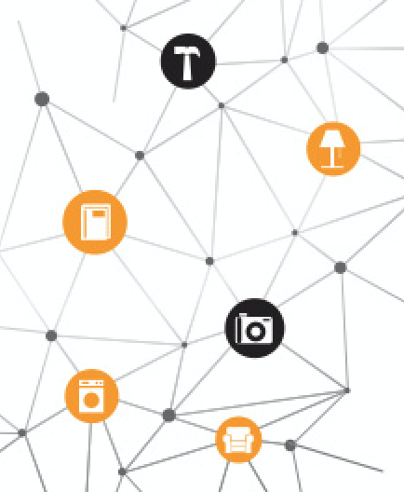
Scaling Up Product Knowledge Extraction
1B
Millions of categories
Scalability
Significant cost reduction for
scale ups
Thousands of attributes
Hundreds of languages
Solution: One-size-fits-all models
Karamanolakis et al., TXtract: Taxonomy-aware knowledge extraction for thousands of product categories, ACL 2020.
Yan et al., AdaTag: Multi-Attribute Value Extraction from Product Profiles with Adaptive Decoding, ACL 2021.

Slide 39
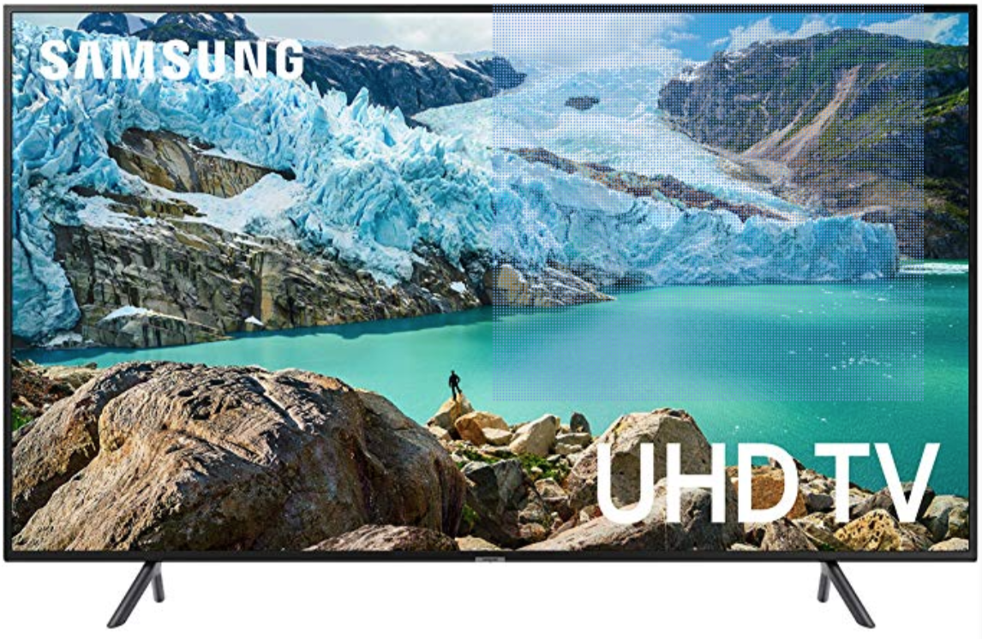
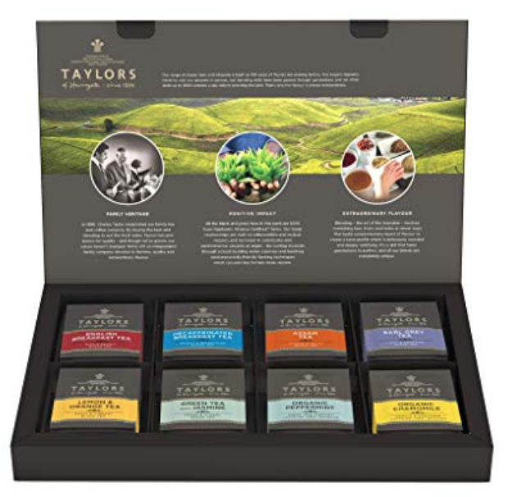
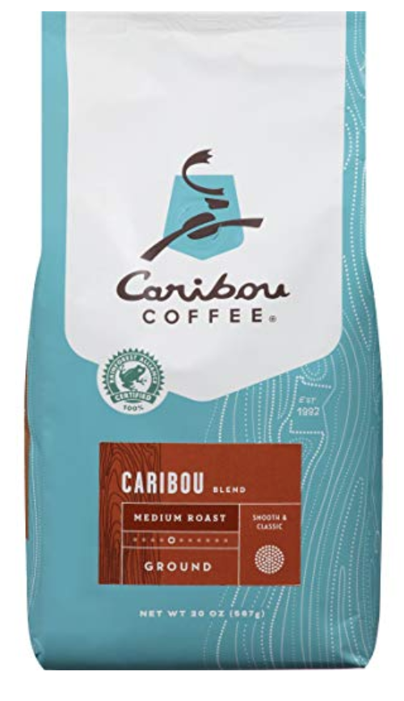



Scaling Up for Millions of Categories
Option 1. Train a single model? Train/Test Distribution shift -> Invalid predictions

Slide 40
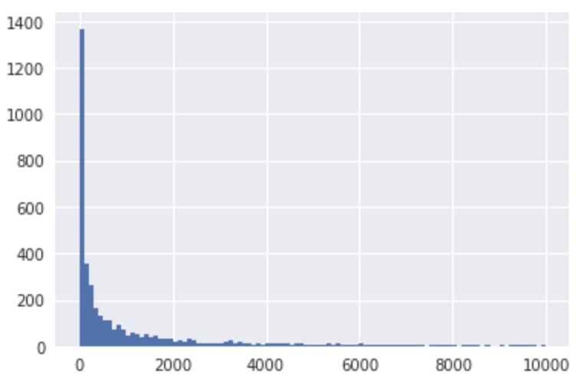
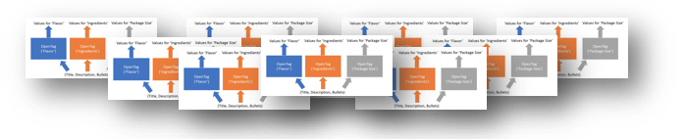
Scaling Up for Millions of Categories
Option 1. Train a single model? Train/Test Distribution shift -> Invalid predictions
Option 2. Train a model for each category?
Store/orchestrate 100K+ OpenTag models
Most categories are very sparse
Karamanolakis et al., TXtract: Taxonomy-aware knowledge extraction for thousands of product categories, ACL 2020.

Slide 41
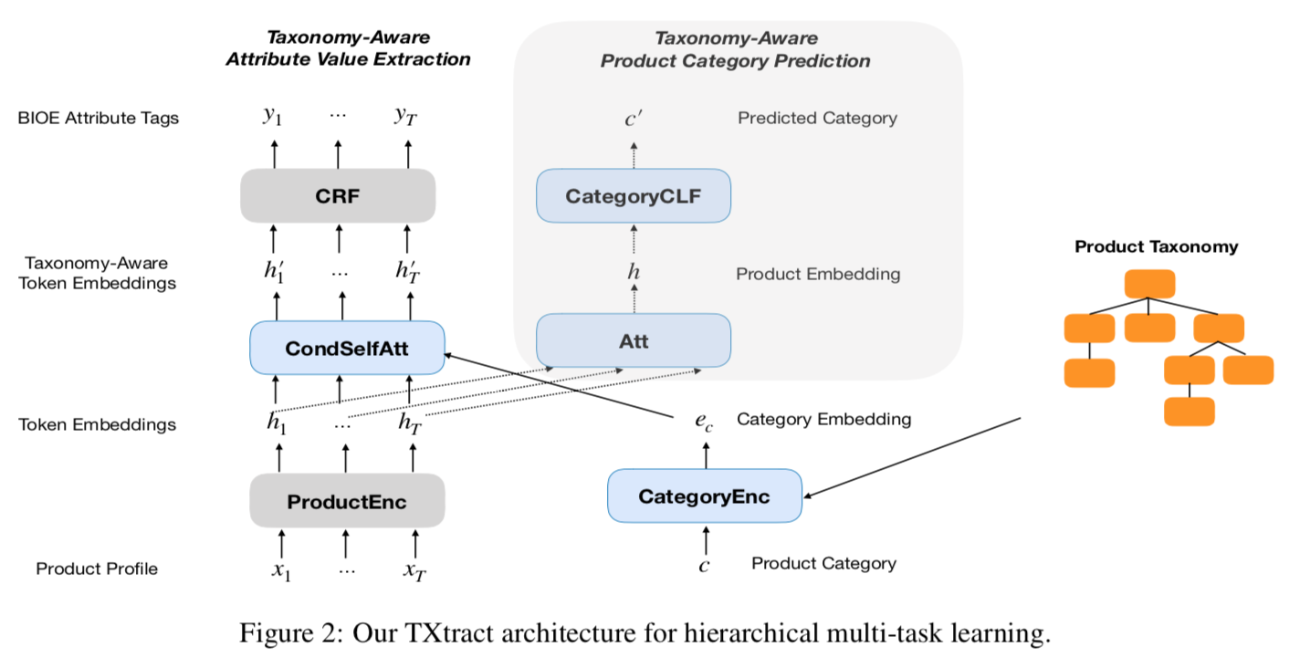
Scaling Up for Millions of Categories
1B
Scalability
Significant cost reduction for
scale ups
Karamanolakis et al., TXtract: Taxonomy-aware knowledge extraction for thousands of product categories, ACL 2020.

Slide 42
Scaling Up for Millions of Categories
1B
Scalability
Significant cost reduction for
scale ups
Attention conditioned on category representation
Karamanolakis et al., TXtract: Taxonomy-aware knowledge extraction for thousands of product categories, ACL 2020.

Slide 43
Scaling Up for Millions of Categories
Multi-task
Learning
1B
Scalability
Significant cost reduction for
scale ups
Karamanolakis et al., TXtract: Taxonomy-aware knowledge extraction for thousands of product categories, ACL 2020.

Slide 44
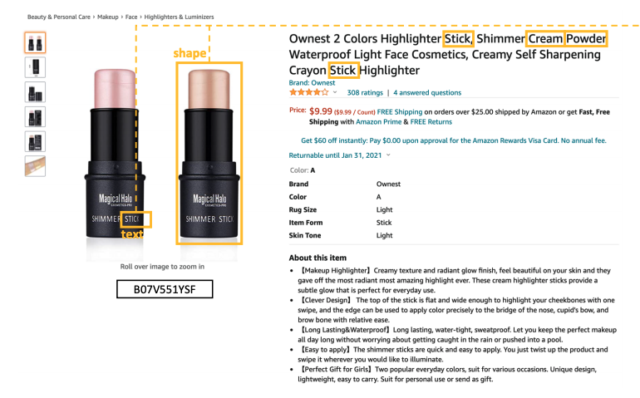
Product Knowl. Extraction from Broader Sources
Product knowledge extraction from images, reviews, etc.
1T
Ubiquity
High coverage, long-tail use cases, assumption removal, to next cycle of inventions
Solution: Multi-modal retrieval
Lin et al., PAM: Understanding product images in cross product category attribute extraction, KDD 2021.

Slide 45
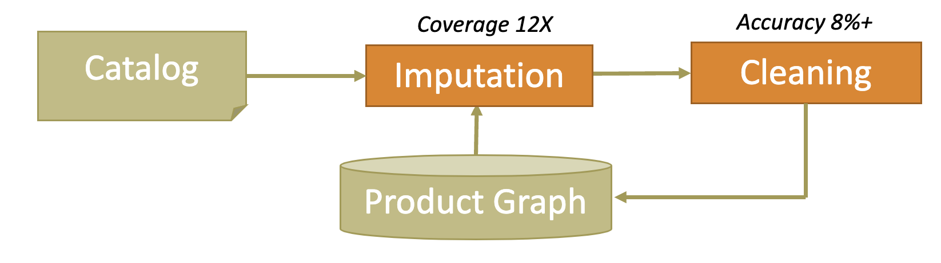

Text-Rich KG Summary
Crazy idea: Finding structure and modeling ambiguity from text-rich sources
Main challenges: Sparse & Noisy structured data everywhere
Framework:
Applications: Product detail display, Search, Recommendation
Unmentioned crazy idea: Automatic taxonomy extraction & construction
Mao et al., Octet: Online catalog taxonomy enrichment with self-supervision. SigKDD, 2020.
Zhang et al., Minimally supervised structure-rich text categorization via learning on text-rich networks. Webconf, 2021
Zhang et al., OA-Mine: Open-World attribute mining for e-Commerce products with weak supervision. Webconf, 2022

Slide 46
Generation #3: Dual Neural Knowledge

Slide 47
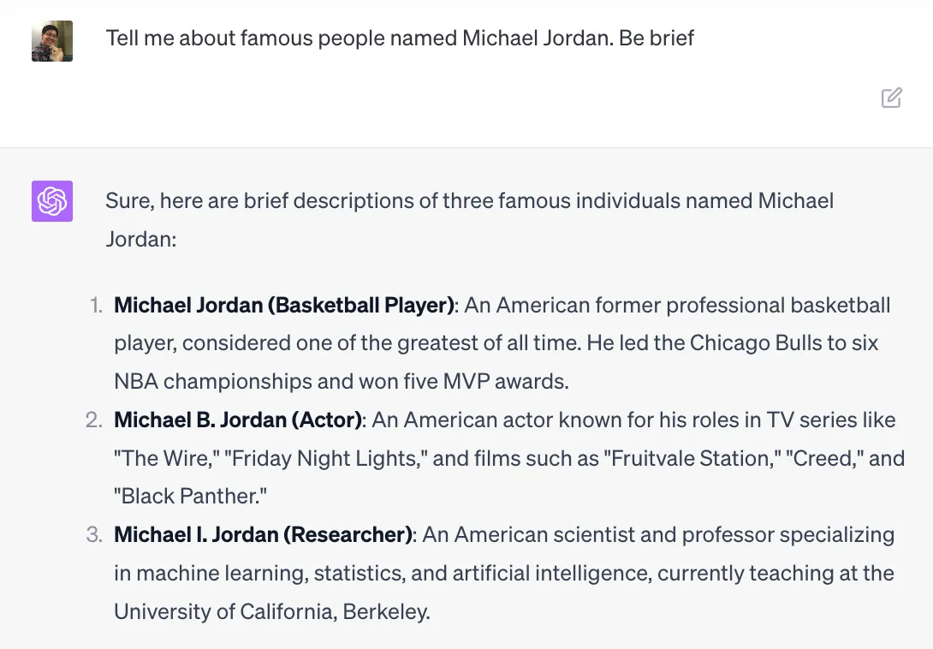

An Example

Slide 48
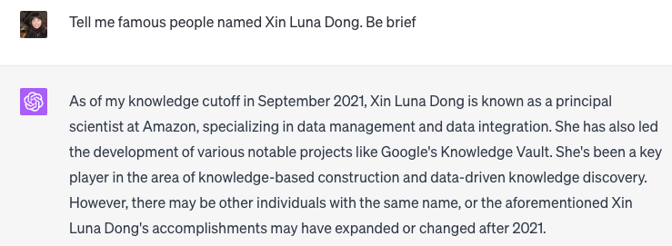
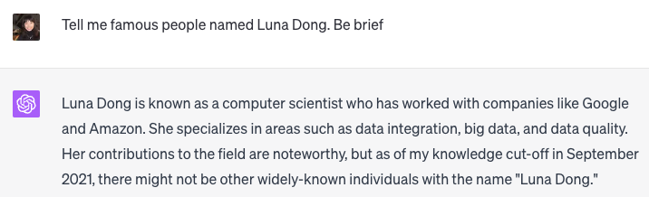
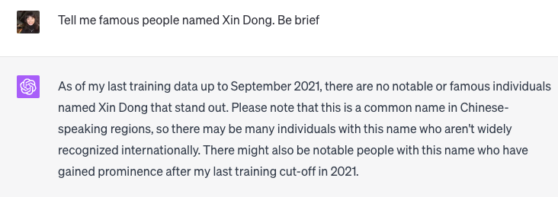
Another Example

Slide 49
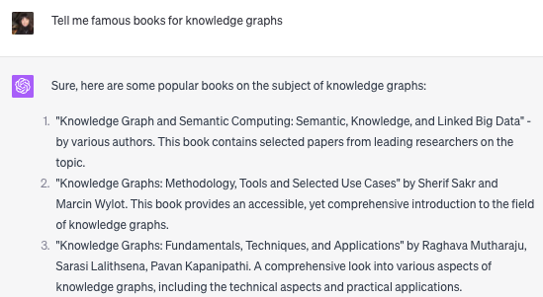
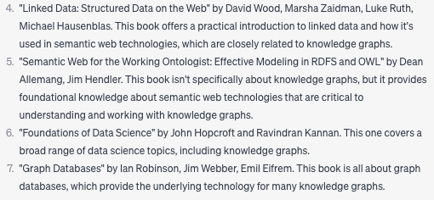
Another Example

Slide 50
Key Questions to Ask Regarding Hallucination
How Knowledgeable are LLMs?
How reliable are LLMs in answering factual questions?
Do LLMs perform equally well across different types of factual knowledge?
Do well-known LLM tricks work?
  Increasing model size
  Instruction tuning

Slide 51
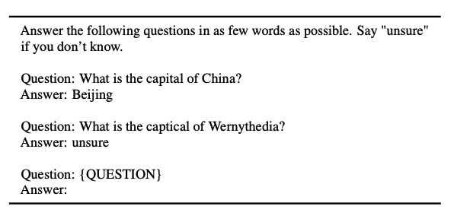
Questions
Sun et al. Head-to-Tail: How Knowledgeable are Large Language Models (LLM)?A.K.A. Will LLMs Replace Knowledge Graphs? arXiv, 2023.

Slide 52
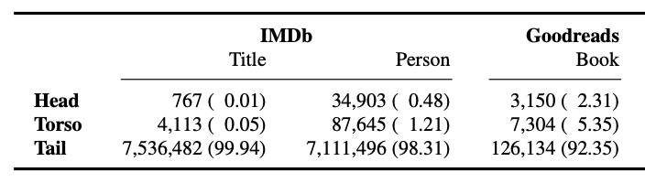
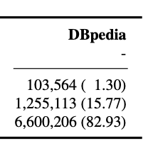
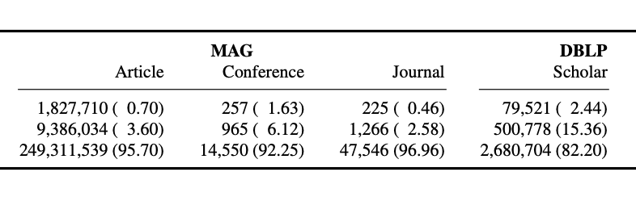
Head-to-Tail Benchmark
When counted by popularity, majority of entities are long-tail
Sun et al. Head-to-Tail: How Knowledgeable are Large Language Models (LLM)?A.K.A. Will LLMs Replace Knowledge Graphs? arXiv, 2023.

Slide 53
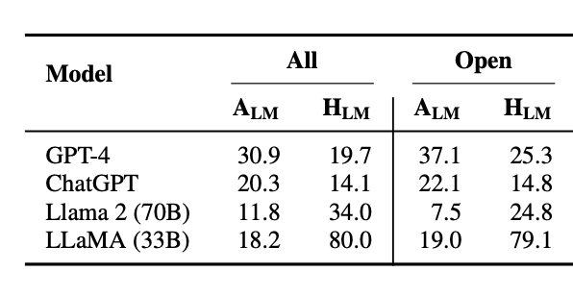
Q1. How Reliable Are LLMs on Factual Questions?
Very low accuracy. Higher missing rate for GPT whereas higher hallucination rate for Llama
Similar for specific domains and general domains
Sun et al. Head-to-Tail: How Knowledgeable are Large Language Models (LLM)?A.K.A. Will LLMs Replace Knowledge Graphs? arXiv, 2023.

Slide 54
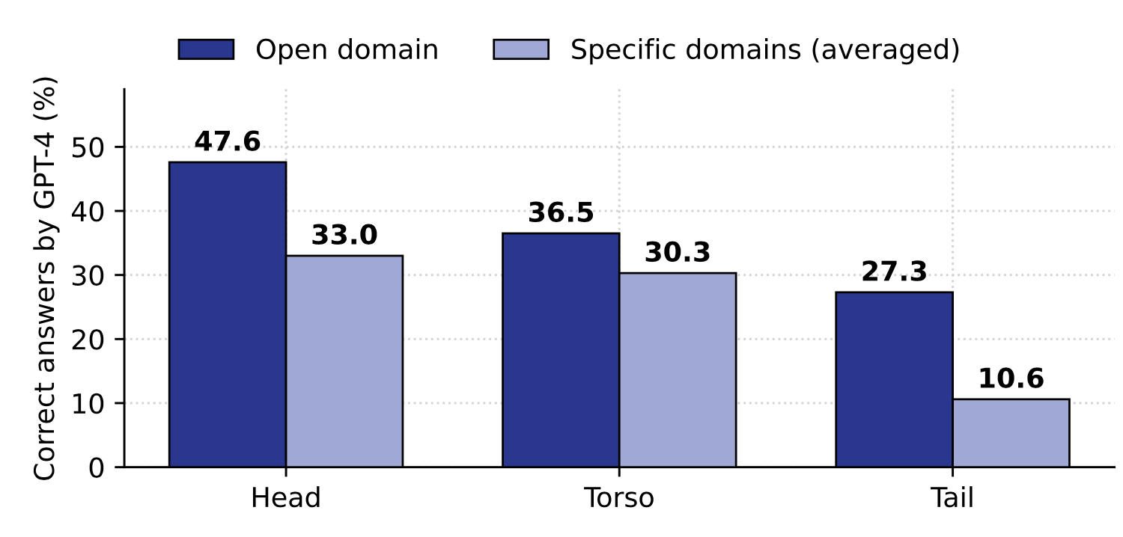
Q2. Performance Similar for Head/Torso/Tail?
Sun et al. Head-to-Tail: How Knowledgeable are Large Language Models (LLM)?A.K.A. Will LLMs Replace Knowledge Graphs? arXiv, 2023.

Slide 55
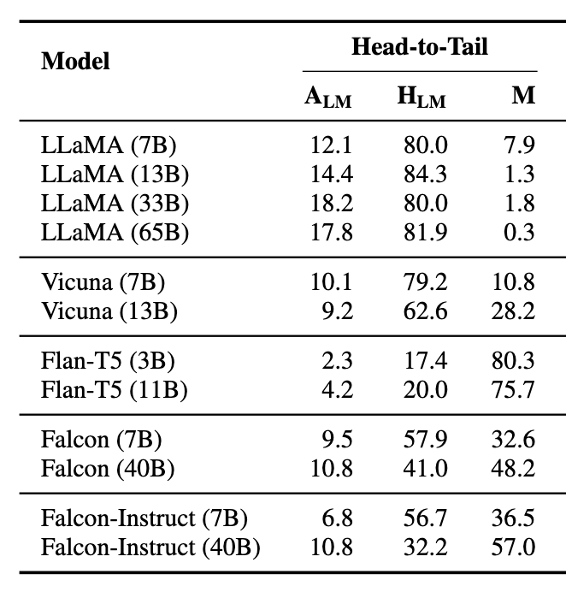
Q3. Do Normal LLM Tricks Help?
Increasing model size does not appear to help significantly
Instruction-tuned counterparts have higher missing rate
Sun et al. Head-to-Tail: How Knowledgeable are Large Language Models (LLM)?A.K.A. Will LLMs Replace Knowledge Graphs? arXiv, 2023.

Slide 56
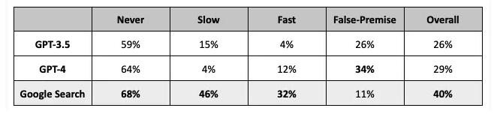
Q3-2. How About Changing Facts?
Good quality for static head facts, comparable to Google Search
Low accuracy for slow or fast changing facts
LLM way better than Google search to detect false premise
Vu, Iyyer, Wang, Constant, Wei, Wei, Tar, Sung, Zhou, Le, Luong. FreshLLMs: Refreshing LLMs with Search Engine Augmentation. arXiv, 2023.

Slide 57
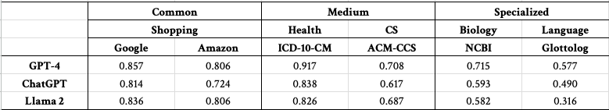
Q3-3. How About Taxonomies?
High quality for common taxonomies, medium-to-low quality for specialized taxonomies
Quality dropping slightly from top to bottom in the taxonomy hierarchical tree
Training Data!!
Xin Luna Dong

Slide 58

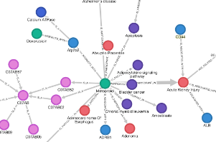
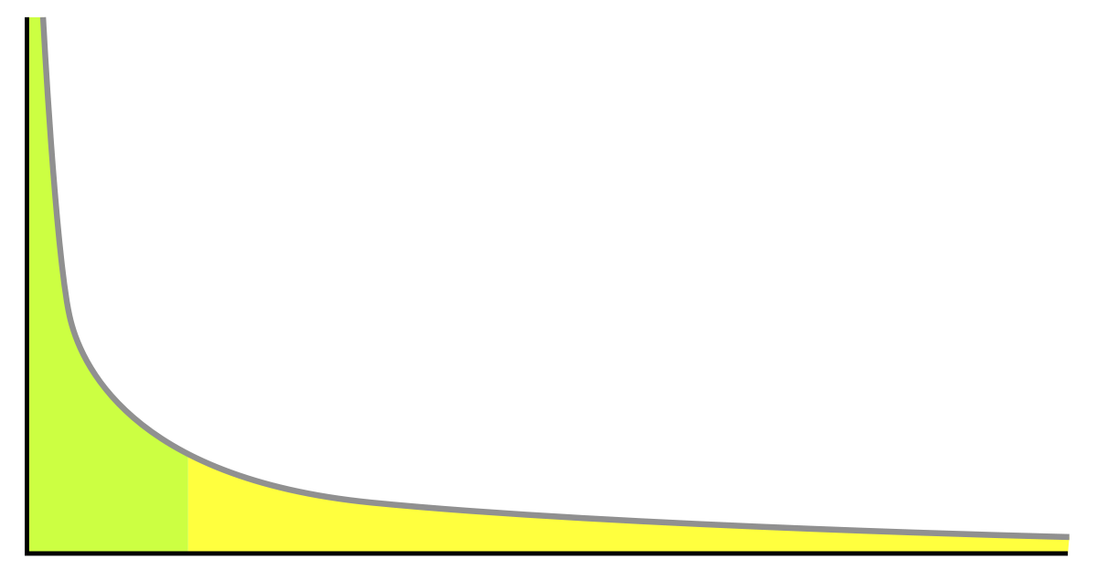
KG Future: Dual Neural Knowledge
Use symbolic taxonomy to represent head classes and specialized taxonomies
Taxonomy
Head Entities
Use both embeddings and symbolic KG to represent head entities
Use embeddings to represent torso / tail classes in common taxonomies
Torso
Use symbolic KG to represent torso / tail entities
Long-tail

Slide 59
KG Future: Dual Neural Knowledge
Use symbolic taxonomy to represent head classes and specialized taxonomies
How to infuse head knowledge into LLMs to enable precise QA?
Taxonomy
Head Entities
Use both embeddings and symbolic KG to represent head entities
Use embeddings to represent torso / tail classes in common taxonomies
RAG: How to seamlessly plug-in external knowledge for QA regarding torso/tail knowledge?
Torso
Use symbolic KG to represent torso / tail entities
Long-tail

Slide 60

Call for Action: CRAG Competition @ KDDCups
Rich Question-Answer Set
2500+ QA pairs from 5 domains (Finance, Sports, Music, Movie, Encyclopedia)
Questions for static, slow-changing, fast-changing, and real-time information
Questions for head, torso, and tail entities
Simple-fact questions and complex questions

Slide 61
Accessible Retrieval Content
125K webpages: 50 webpages for each question from BraveAPI web search
Mock KG: 3K fact triples, 30:1 signal-to-noise ratio
Reliable Tasks and Evaluation
Task 1: Answer generation over top-5 web search results—Answer Generation
Task 2: + Mock-KG Search API—Structured Query Search, Answer Selection
Task 3: + 50 web search results—Search Ranking

Slide 62

Baseline Quality
RAG may improve performance
RAG may also bring more hallucinations

Slide 63
Baseline Quality
KDDCup Competition will be announced in mid-March
Join the force to reduce the gap!

Slide 64
Take-Aways. 3 Generations of KGs
1. Entity-Based KGs
2. Text-Rich KGs
3. Dual Neural KGs
Resolving heterogeneity with entity linkage and web knowledge extraction
Extractions and cleanings from sparse and noisy source data, and handling semantics ambiguities
Knowledge infusion into LLMs, and seamless knowledge augmen-
tation to facilitate LLMs

Slide 65
Take-Away 2. From Roofshots to Moonshots
1
0
0
0
0
0
0
0
0
0
0
0
0
,
,
,
,
Feasibility
Quality
Repeatability
Scalability
Ubiquity
Roofshots
Moonshots

Slide 66
Thank You
Q&A?

