Slide 1
Point-of-interest Re-ranking by Modeling Session Context and Geography-semantics Interaction
Lang Mei

Slide 2




Background
POI Search
Location-based services
Online Navigation Applications
Online Ride-hailing Platforms

Slide 3
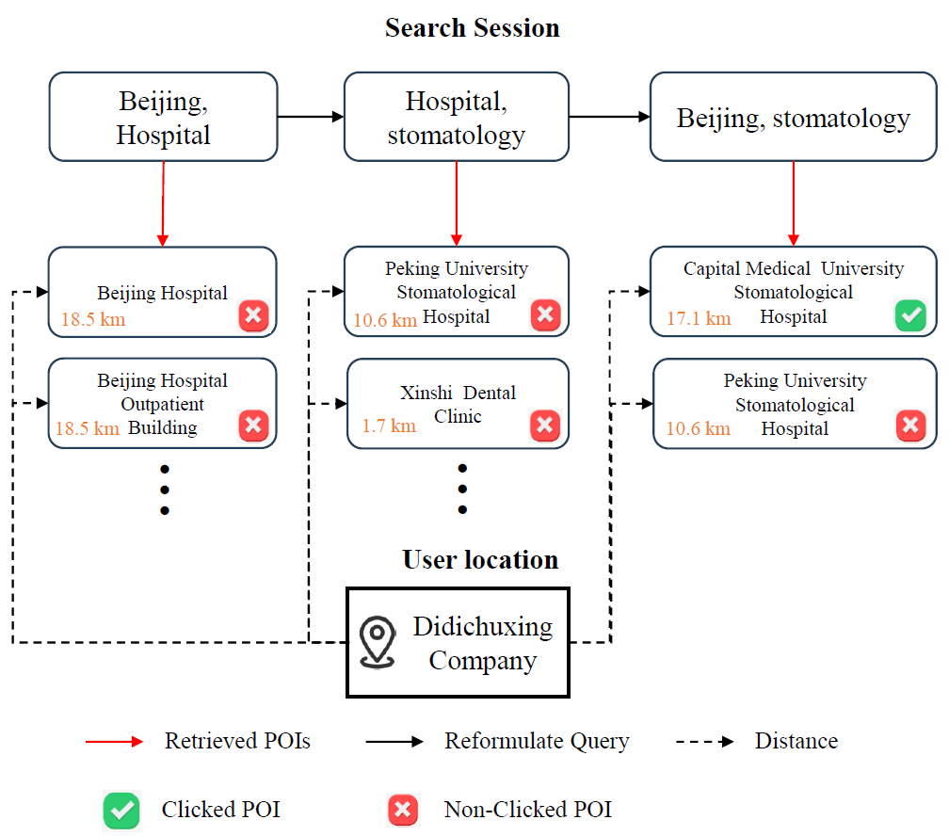
Background
POI Search Session: Re-ranking
issuing queries → → → click POI
Related Work
  Ad-hoc
  Session Search
Limitations:
  implicit feedback (i.e., non-click)
  geography-semantics context
examining ranked POIs
reformulating queries

Slide 4




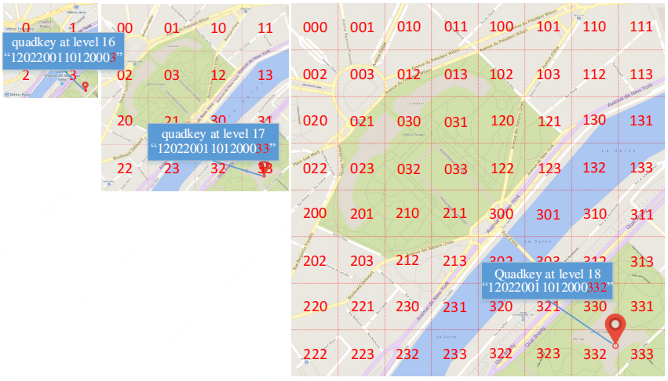

Methodology
Formulation
POI Search Session
  Reformulated queries
  Returned POI list at timestep t
  Target POI
    POI Context
      Name, address, location
Geohash Code for Location
  Geographical coordinates
  Geographical hierarchy

Slide 5
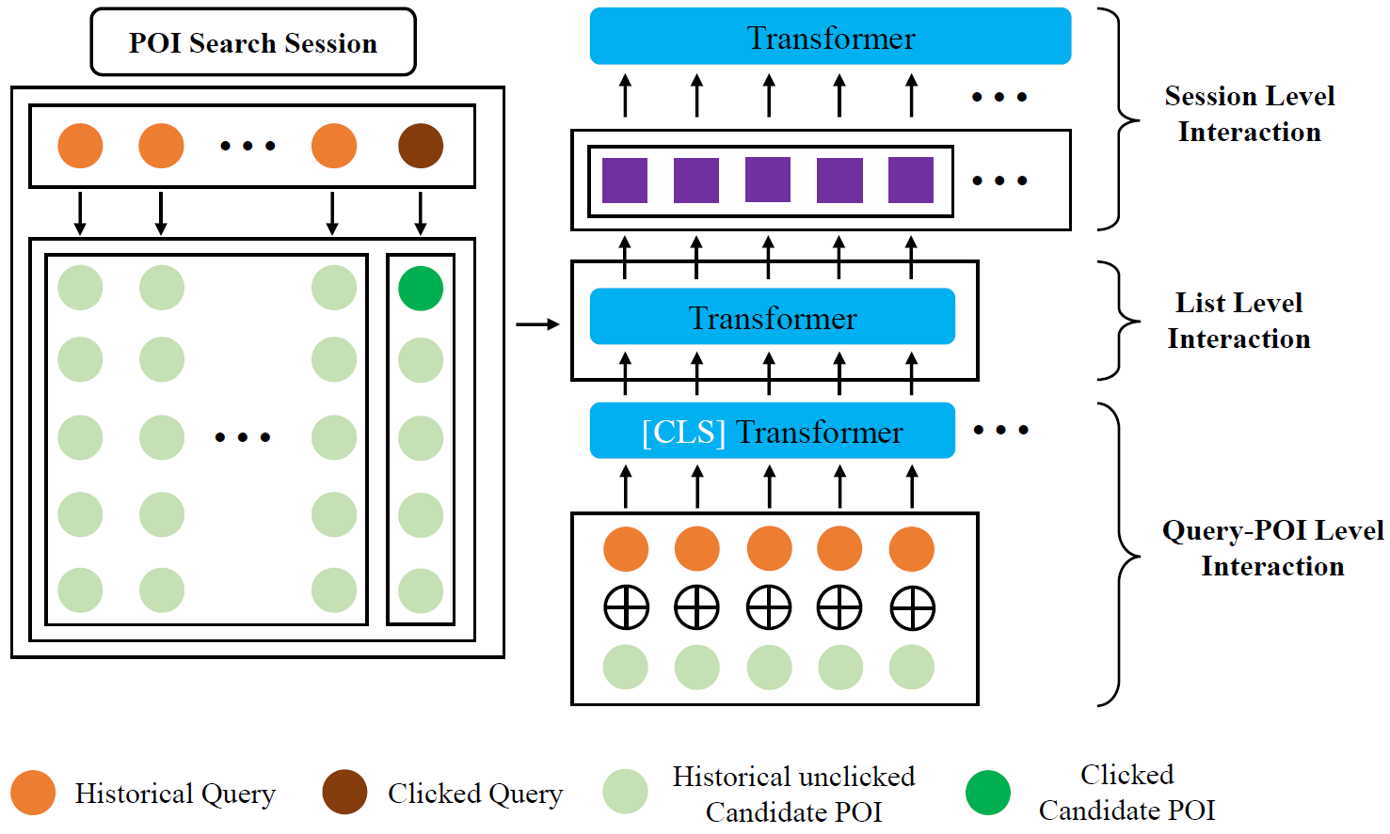
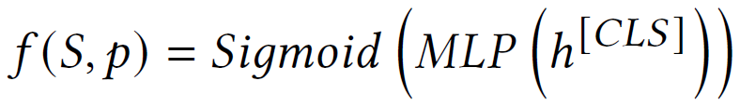
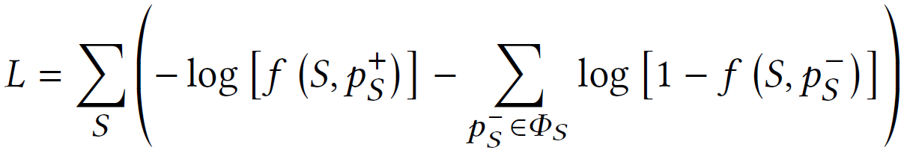
Methodology
POI Session Encoder
fine-grained interactions at three levels of granularity
  Query-POI Level
  List Level
  Session Level
Modeling relevance
Training Objective

Slide 6
Experiment
Real-world Dataset
Didichuxing application’s data, August 2022
16,717,537 click logs (i.e., search session)
1,713,280 POIs
1,530,964 distinct queries
Evaluation
MRR@𝐾 and NDCG@𝐾, (𝐾 ∈ {1, 3, 5, 10}).
Baselines
Ad-hoc Ranking Models
  LSTM-DSSM
  PALM, ST-PAC, Meta ST-PAC, DrW
  Ad-hoc Bert Re-ranker
Context-aware Ranking Models
  HQCN (Geo)
  ASE (Geo)
  Session Query Bert Re-ranker

Slide 7
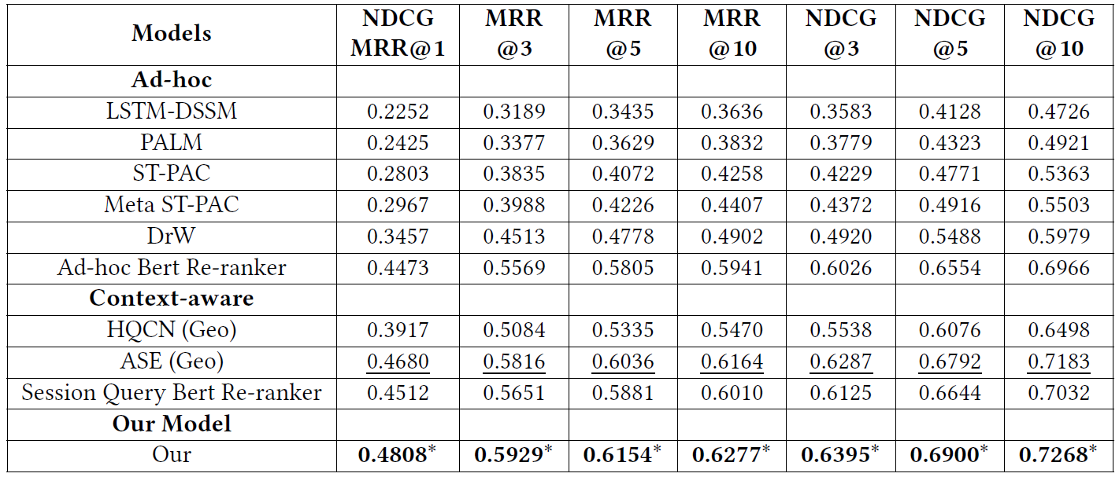
Experiment
Results and Analysis: Re-ranking Performance
Geographical context
We use paired t-test with p-value threshold of 0.05. ∗ indicates significant difference over best baselines.

Slide 8
Experiment
Results and Analysis: Re-ranking Performance
POI session context
We use paired t-test with p-value threshold of 0.05. ∗ indicates significant difference over best baselines.

Slide 9
Experiment
Results and Analysis: Re-ranking Performance
Pre-training model
We use paired t-test with p-value threshold of 0.05. ∗ indicates significant difference over best baselines.

Slide 10
Experiment
Conclusion
Re-ranking stage of the POI search
Limitations:
  implicit feedback (i.e., non-click)
  geography-semantics context
POI Session Encoder
  query-POI level
  list level
  session level
Real-world datasets from Didichuxing
Future Work
Goal of the POI search system
  Finding users’ target POIs in a one-time query-POI matching.
  minimizing cumulative user effort throughout the entire POI search session.

Slide 11
Thanks for Listening!

