Slide 1
DeepMMATE: Deep learning based MultiModal architecture for Audit Taxability classification with XAI
Y V S Harish
Applied Scientist
Amazon

Slide 2
General Introduction - Audit
Tax audit : Process where an independent body examines the transactional accounts of an organization to authenticate the firms dealings.
It is essentially a healthy feedback loop which ultimately results in an efficient tax collection model.
In case of transactional tax, the E-commerce company is responsible for collecting tax from consumers in accordance with the statues/regulation and pay it to Tax authorities.

Slide 3
E-commerce Tax Audits:
E-commerce companies hosts millions of coming from various vendors across the globe.
Every year, an external authority from respective country/state compliance team visits them to perform an audit where they cross check if the products sold are correctly taxed or not.
Before this external audit, these companies cross check the product taxability.
It cross checks the taxability predictions made by the source team to avoid any unnecessary penalties incurred to them during the actual audits by the respective country/state compliance teams.
Challenge:
Even when the products look similar or belong to the same category, their taxability might differ depending upon the manufacturing ingredients, description, type of audience its intended to, state in which they are sold, price bracket etc.

Slide 4
Process Followed:
In general, audit teams manually review high-valued products to avoid penalty in actual audit. The following steps describes the process briefly:
The audit team fetches dataset to be reviewed from an internal source.
Shortlists the high-valued products(categorized as Non-Taxable initially) based on net selling price.
Goes over the product images on the E-commerce site.
Fetches details like: Fact Labels, manufacturing ingredients, description & other keywords which will help determine the category of the product.
Once the final category is decided it then derives product taxability manually based on taxability rules in different states in US/other countries.

Slide 5
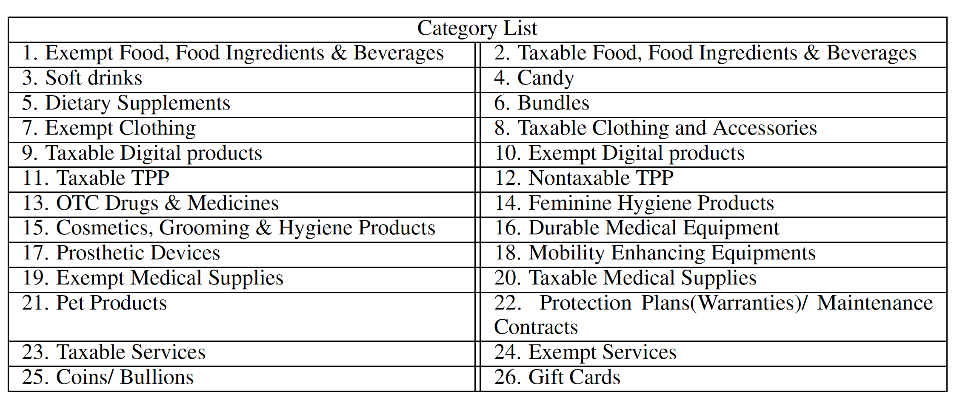
List of states that were considered for the audit experimentation
List of categories a product can be classified into before predicting the final taxability

Slide 6
ML solution Modelling

Slide 7
Parent-Child architecture – End to End workflow
1. Product
2. Input Features to
Model
3. Model Architectures
4. Output
Taxability
Output Category
Yes or No
Fetch [Product Images] / [Product Title, Feature Bullets, OCR data etc..]
…
1
Input Product
Parent Model
7
Child Models
1. Multimodal [Vision + Language] [ResNet + SeqBERT, EfficientNet+ MPNet.. Etc.]
2. Vision only Models
[ResNet, EfficientNet]
3. Language only Models
[ BERT, MPNet ]

Slide 8
Exempt Food, Food Ingredients & Beverages
Taxable Food, Food Ingredients & Beverages
Soft Drinks
Candy
Dietary Supplements
OTC Drugs & Medicines
Durable Medical Equipment
Prosthetic Devices
Mobility Enhancing Equipment
Exempt Medical Supplies
Taxable Medical Supplies
Cosmetics, Grooming & Hygiene Products
Feminine Hygiene Products
Coins/Bullions
Gift Cards
Pet Products
Protection Plans(warranties)/Maintenance Contracts
Bundles
Exempt Clothing
Taxable Clothing Accessories
Taxable Services
Exempt Services
Taxable Digital Products
Exempt Digital Products
Taxable TPP
Non Taxable TPP
Category Specific Model
Category Specific Model
Category Specific Model
Category Specific Model
Category Specific Model
Category Specific Model
Category Specific Model
Food
Clothing
Medication & Hygiene
Services
Misc_1
Digital Products
TPP’s
Parent Model

Slide 9
Models & Feature Selection

Slide 10
Vision only Models
Models
AlexNet
VGG
ResNet
Inception
EfficientNet
Input Data
Product images
Digital Product
OTC Drugs & Medicines
Soft Drink
Clothing

Slide 11
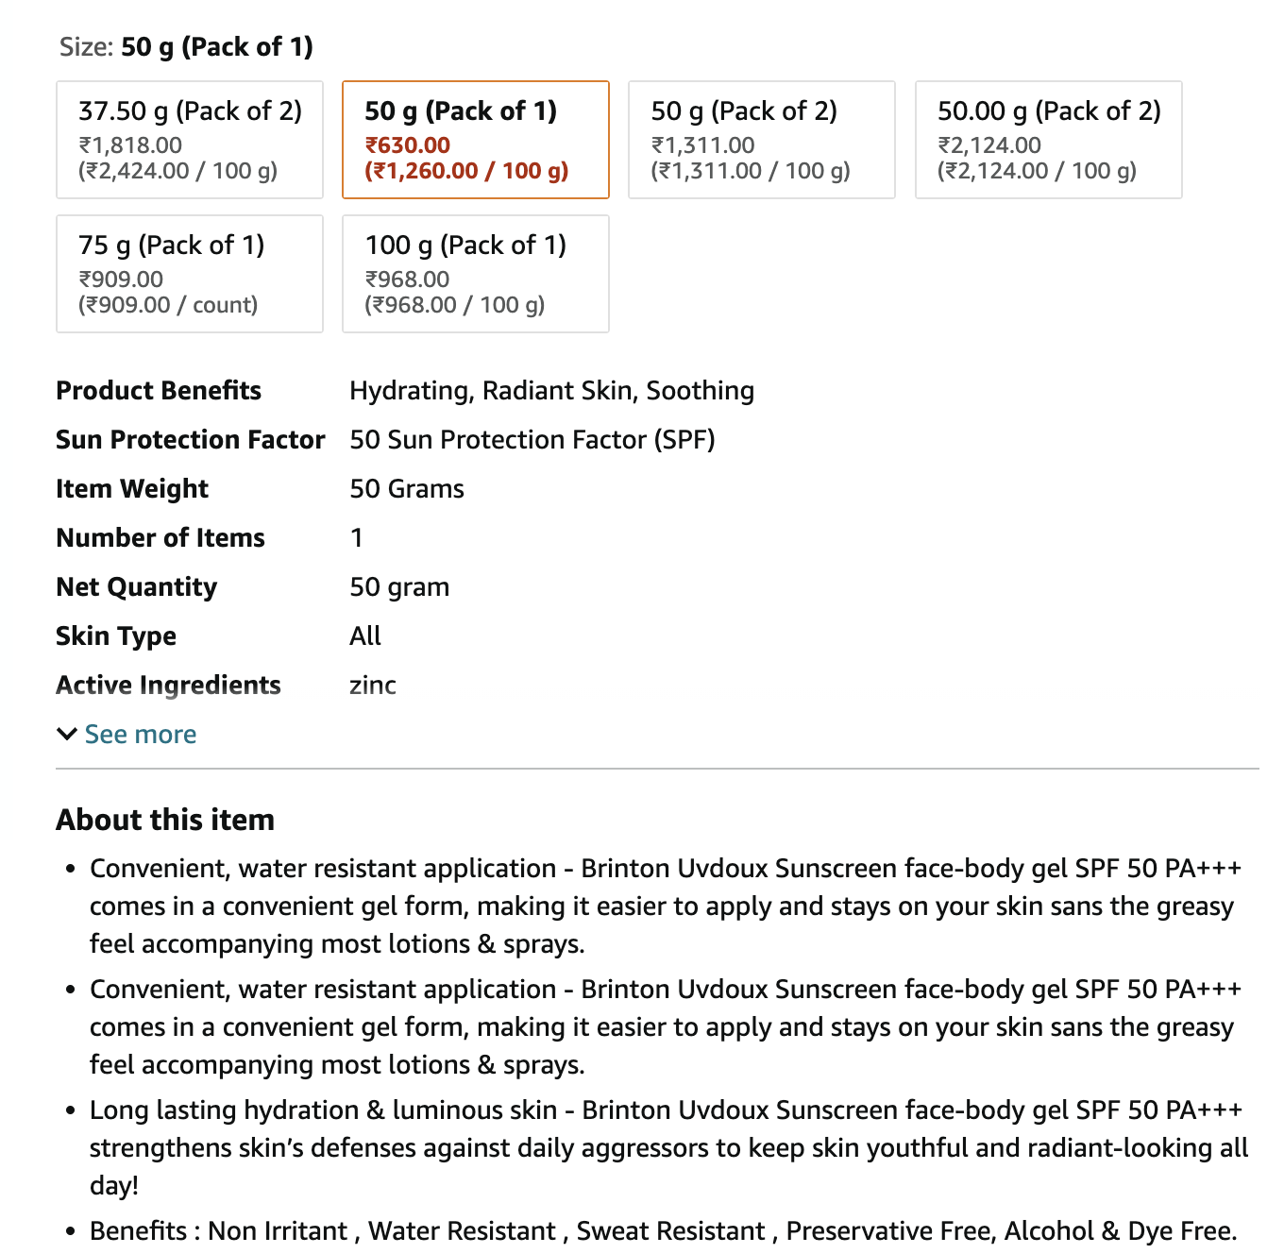
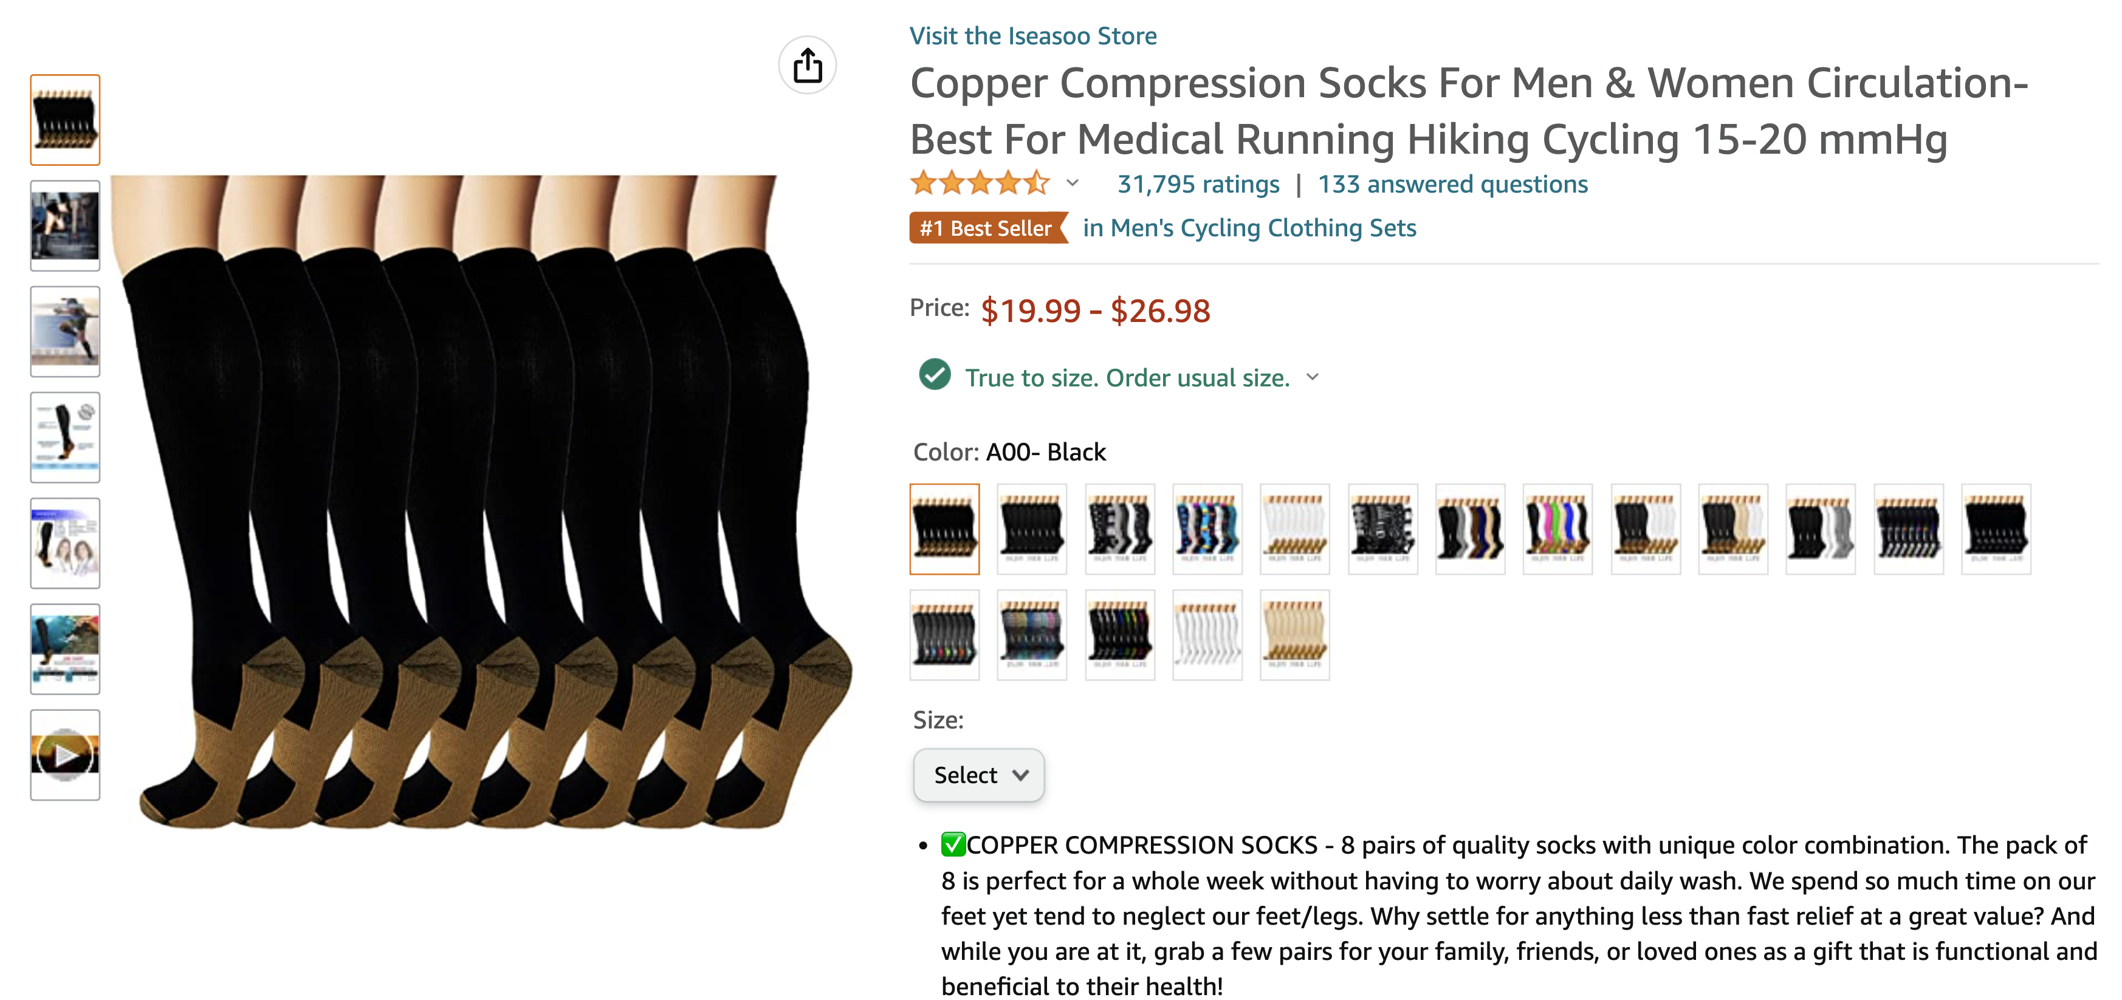
Language based Models
Models:
MPNET
BERT
XLNET
RoBERTa
Input Data:
Product API data
Product description
Product Title
Product Feature bullets
OCR text from product images
Digital Product
OTC Drugs & Medicines
Clothing
Soft Drink

Slide 12
Vision Models
ResNets : These networks were mainly designed to mitigate gradient loss in very deep architectures. The identity mapping helps learns residual mappings instead of learning the entire function map. The input (X) is passed through a two-layer path (approximating F(X)) and a skip connection path. The outputs of the two paths are summed at the output of the ResNet.
Efficient Net : The Efficient Net architecture proposes scaling using compound coefficient, a simple, efficient technique. This technique scales the dimensions of depth, width and resolution in a uniform manner using scaling coefficients. The balanced scaling improves overall performance rather than just increasing accuracy. The compound scaling balances the scaling dimensions using a constant ratio.
Language Models
BERT : BERT, short for Bidirectional Encoder Representations and Transformers is used as a pre-trained sentence encoder. BERT adopts masked language model (MLM) enabling bidirectional learning from text by masking a word in a sentence and forcing it to use the words on the either side of the covered word to predict the masked word.
MPNet : MPNet adopts a novel pre-training method, named masked and permuted language modelling, to inherit the advantages of masked language modelling and permuted language modelling for natural language understanding.

Slide 13
Language + Vision : Multi Modal Architecture
Product title, Feature
Bullets etc. from website
Language based Models
Product detail API
768
Input to
Textract
Textract
Processed Text
from Images
Output Categories
Taxability
Classification layers
Product Images /
details
2816
Vision based Models
2048
Product Images

Slide 14
Experiments and Results

Slide 15
F1 Score - Quantitative Comparison
The above reported metrics are from the best performing models, for the vision only architecture it is out of Res-Net and
Efficient-Net(B7 version), for the language only model it is between BERT and MPNet & for the Multimodal architecture we
report the best performing model from various possible combinations of the above two [in this case a combination of ResNet-152 and
SeqBERT was best performing multimodal.]

Slide 16
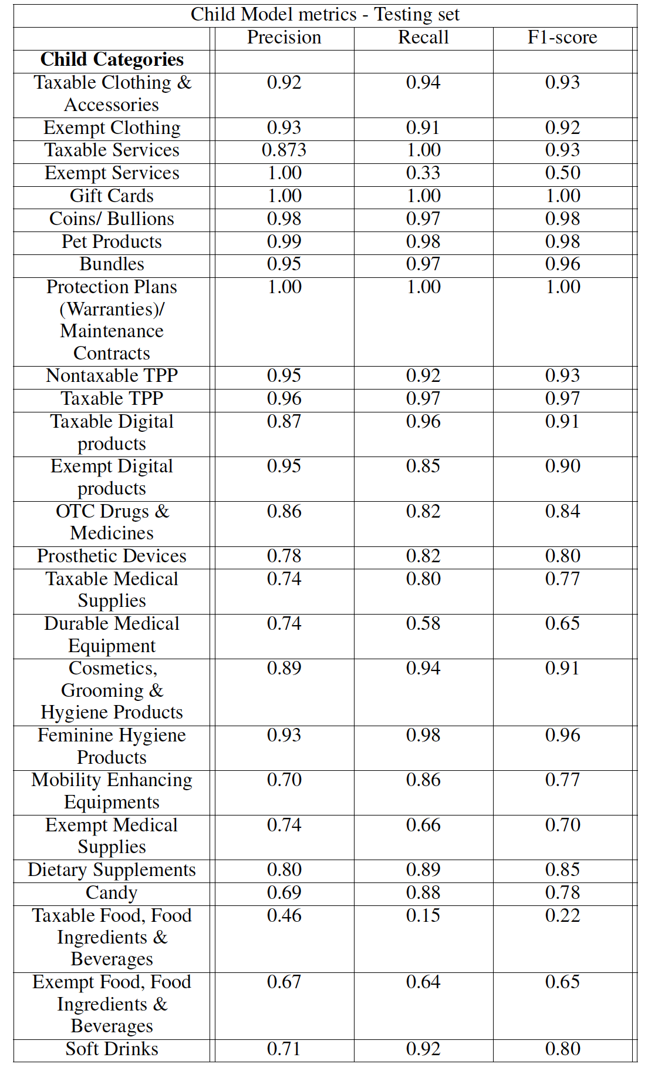
Quantitative Metrics – Child Models

Slide 17
Explainable AI

Slide 18
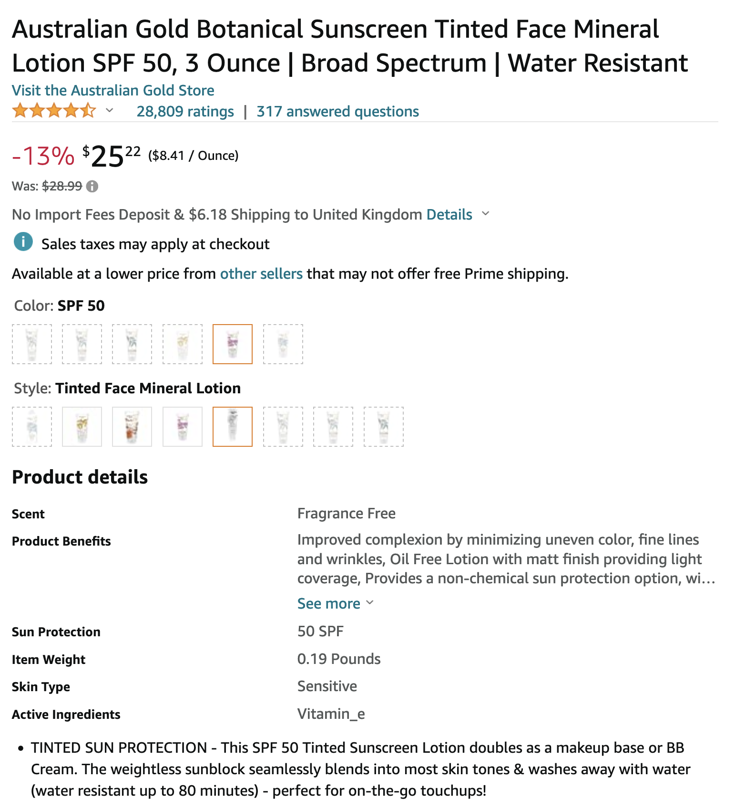
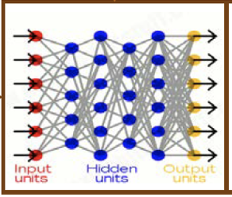
Why did you do that ?
Why not something else ?
When can I trust you ?
When do you succeed ?
When do you fail ?
Before XAI
Test Input
Learning Process
Taxability - No
This is Exempt Food
(p=0.93)
Training Data
Machine Learning
model
Output
User/Auditor

Slide 19
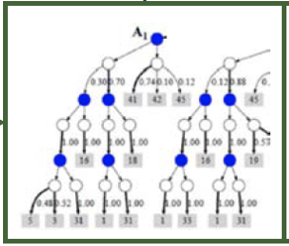
Why did you do that ?
Why not something else ?
When can I trust you ?
When do you succeed ?
When do you fail ?
Before XAI
Test Input
Learning Process
Taxability - No
This is Exempt Food
(p=0.93)
Training Data
Machine Learning
model
Output
User/Auditor
I understand why.
I understand why not.
I know when to trust you.
I know when you’ll succeed
I know when you’ll fail.
I know why you erred.
After XAI
Test Input
Taxability - Yes
This is Candy
* Peppermint Sticks
* Sweet Stripes
* Candy
…..
Learning Process
Training Data
Explainable
Machine Learning
model
Explainable
interface
User/Auditor

Slide 20
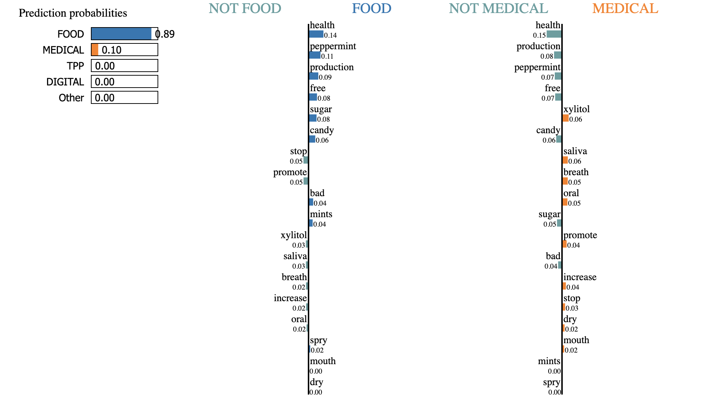
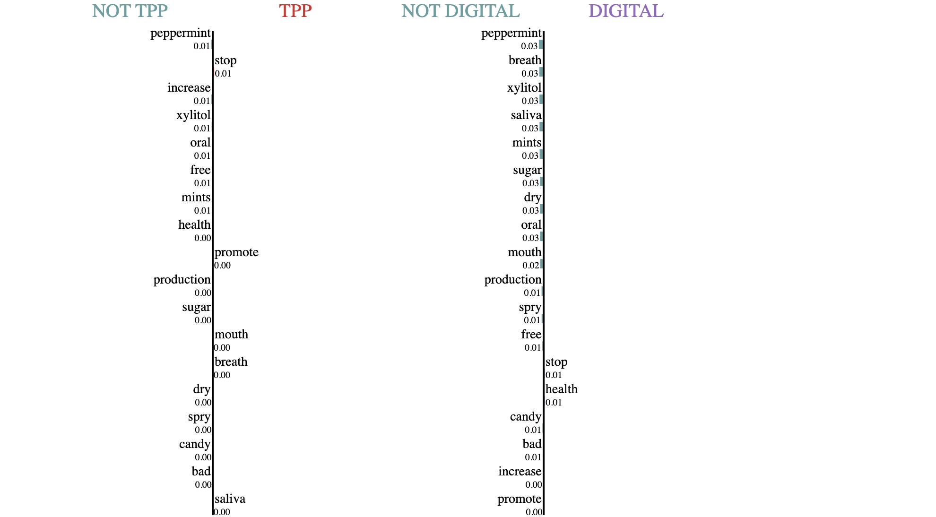
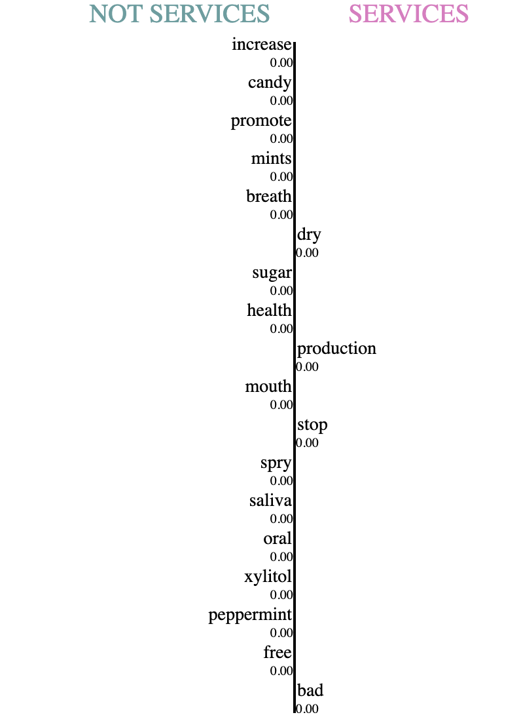
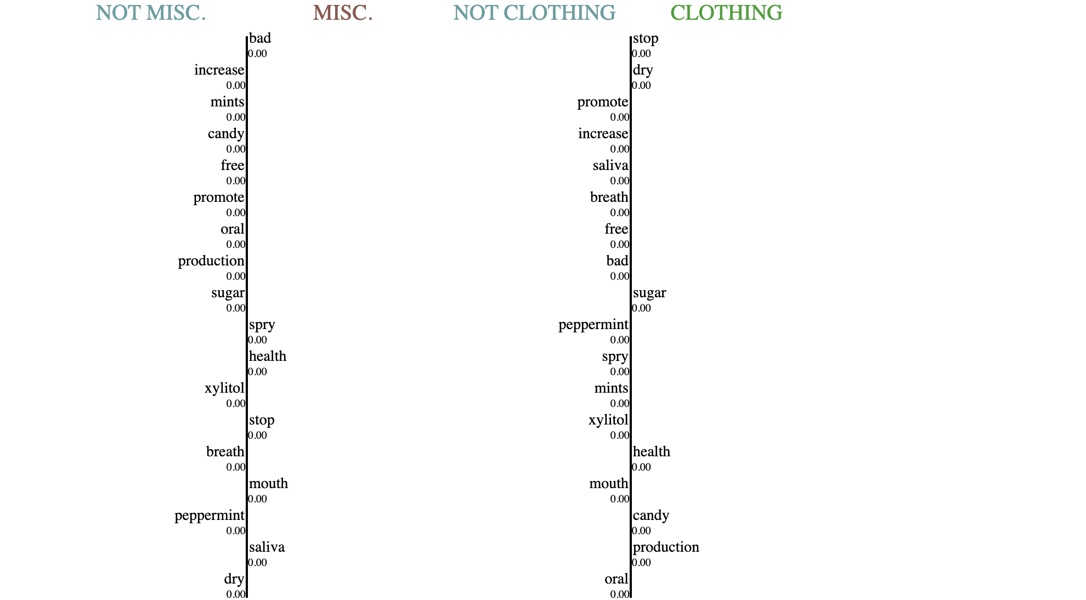
Sample product Title:
"Spry Xylitol Peppermint Sugar Free Candy - Breath Mints That Promote Oral Health, Dry Mouth Mints That Increase Saliva Production, Stop Bad Breath"

Slide 21
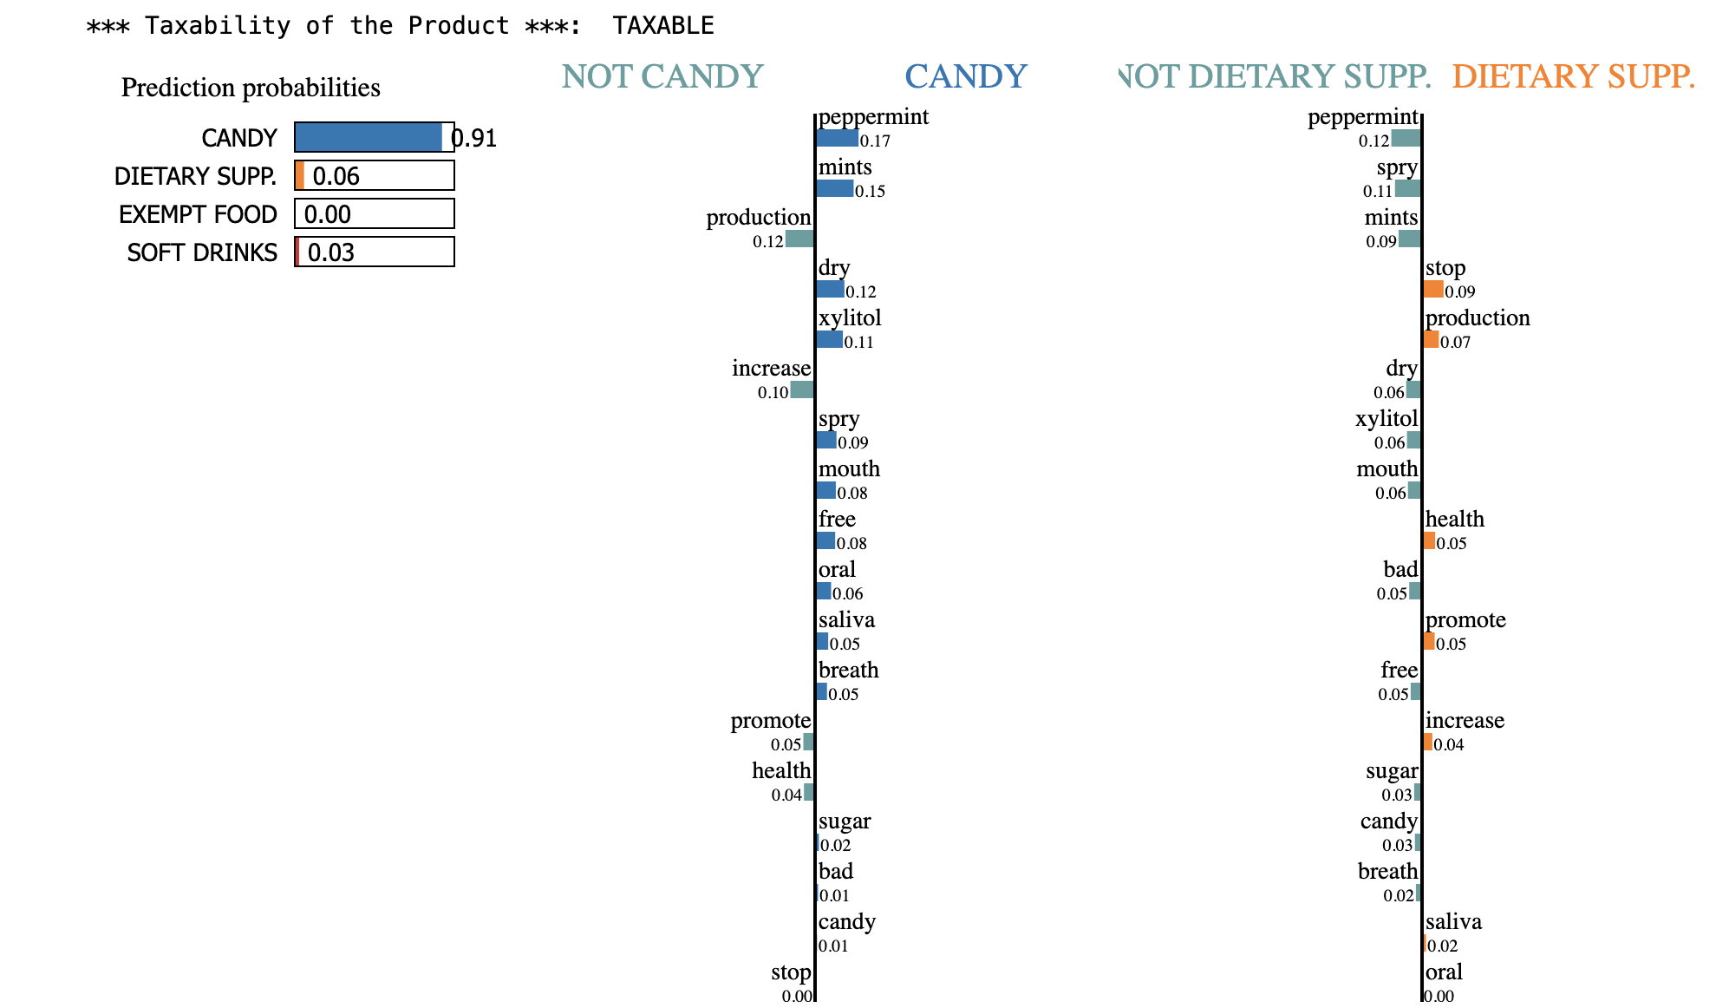
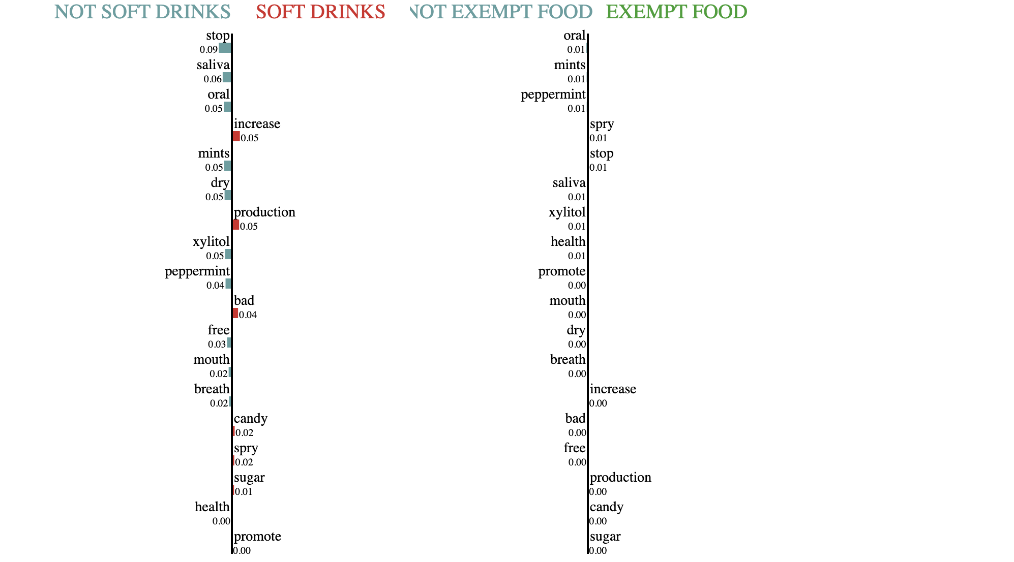

Slide 22
Future Work

Slide 23
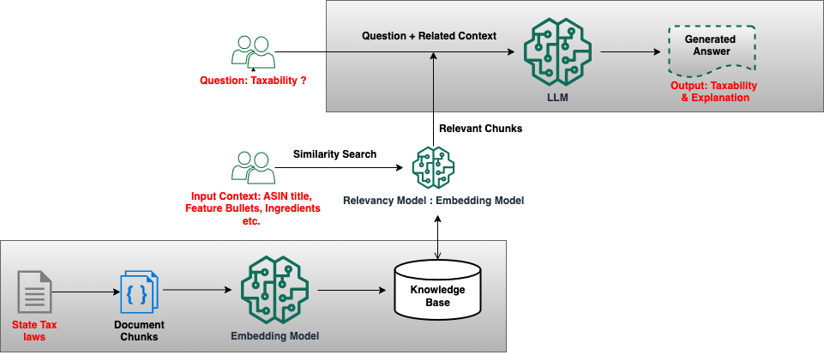
What Next ? – Gen AI
Sample Output:
Product ID | Proposed Taxability | Explain ability | Top 4 Page References from Tax Law PDF
B000R4CIBS | YES | The product described is a carbonated beverage that contains preservatives and additives. According to the context, carbonated beverages are generally taxable, and products containing preservatives or additives like potassium benzoate and artificial flavours are also taxable." | 5,4,7,28
B00B04IRDC | NO | KeVita Sparkling Probiotic Drink is a non-alcoholic, non-carbonated beverage. It is considered a food product, so its sale is not taxable." | 5,7,4,8
B00QJ7XV2M | YES | The product contains dietary supplements and artificial flavours which are taxable according to the context. It does not qualify as an exempt food product." | 5,7,28,8
B09CG42GZ7 | NO | 100% Organic Matcha Green Tea Powder is considered a food product and its sale is generally exempt from tax." | 5,7,4,28

Slide 24
Thankyou

Slide 25
List of Categories
Exempt Food, Food Ingredients & Beverages
B083X6TSHQ
Taxable Food, Food Ingredients & Beverages
Soft drinks
Candy
Dietary Supplements
Bundles
B0091R0MWY
Exempt Clothing
Taxable Clothing and Accessories
Taxable Digital products
https://www.amazon.com/dp/B0851ZKL8L
https://www.amazon.com/dp/B074P78LB5
Exempt Digital products
B003UONVNG
https://www.amazon.com/dp/B00ETF7E6K
https://www.amazon.com/dp/B08XR1G8SW
Taxable TPP - [ref: https://floridarevenue.com/property/documents/pt114.pdf] - [Non - Exempt product is marked as this]
https://www.amazon.com/dp/B0714BDBXV
https://www.amazon.com/dp/B01MSPITRM

Slide 26
Nontaxable TPP [Exempt product is marked as this]
https://www.amazon.com/dp/B01C3DIDN2
OTC Drugs & Medicines
https://www.amazon.com/dp/B00U2KYU7C
Feminine Hygiene Products
Cosmetics, Grooming & Hygiene Products
Durable Medical Equipment
Prosthetic Devices
Mobility Enhancing Equipments
Exempt Medical Supplies
Taxable Medical Supplies
https://www.amazon.com/dp/B011WDV12Y
Pet Products
Protection Plans (Warranties)/ Maintenance Contracts
Taxable Services
Exempt Services
Coins/ Bullions
Gift Cards

