Slide 1


CAPS: A Practical Partition Index for Filtered Similarity Search
Gaurav Gupta^{1,3}, Jonah Wonkyu Yi¹, Benjamin Coleman⁴, Vihan Lakshman², Chen Luo³, Anshumali Shrivastava^{1,2}
[1] Rice University, [2] ThirdAI Corp., [3] Amazon Search, [4] Google Deepmind

Slide 2
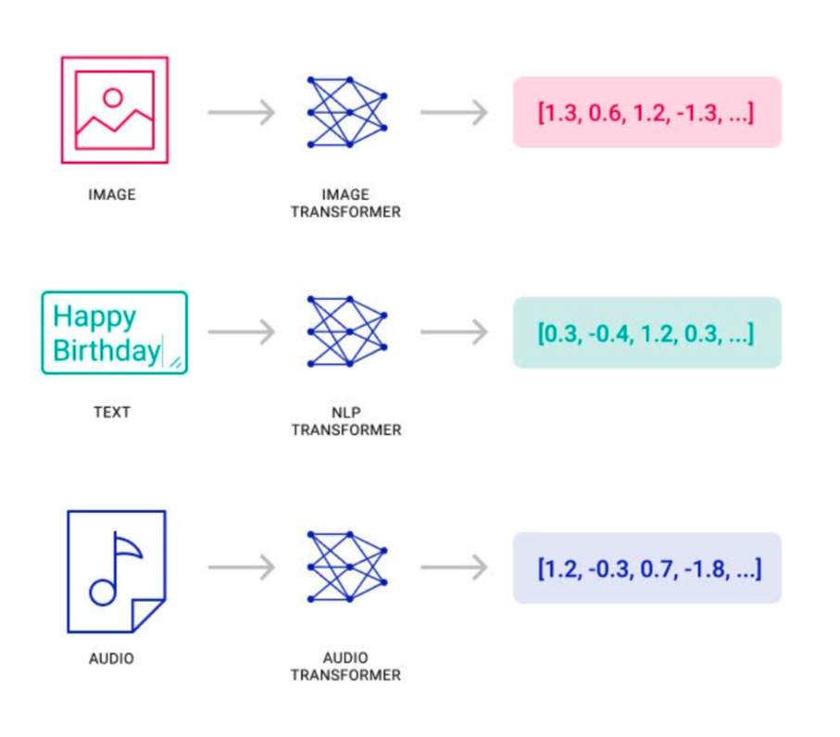
Recommendation system
Represent an item as vector embedding
  CNN/ViT for image
  Transformers for text
  Audio transformers for audio data
  Positive and negative pairs of items, encoded via collaborative filtering
Represent a query as a vector embedding
Perform near-neighbor search
  Find top-k items on a similarity metric (cosine, Euclidean)
https://www.pinecone.io/blog/rise-vector-data/

Slide 3
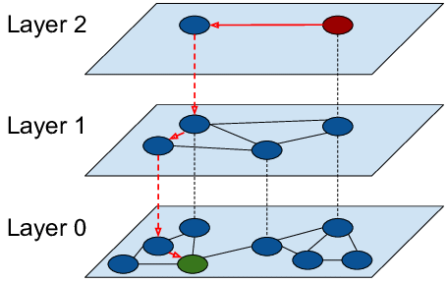
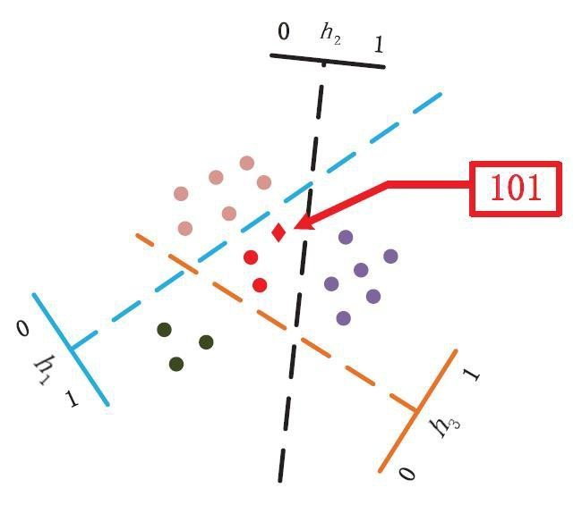

Near neighbor Index
Brute force near-neighbor search = $O(Nd)$
Near neighbor index $≪O(Nd)$
Million-Billions of Item embeddings
ANN Graph (HNSW)
Near-neighbor
Index
Query Embedding
Top 100 candidates
Space Partitioning (LSH)

Slide 4
Why vector embedding?
It encodes semantic information.
Encodes both the content (query/item features) and collaboration (query-item interaction)
Caters to all types of data-natural, discrete, continuous, etc.

Slide 5
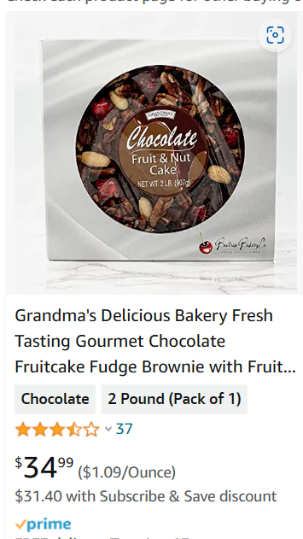

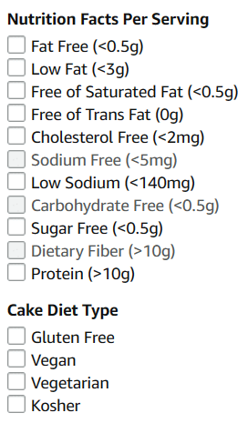
Practical recommendation use-case
Practical recommendation models often need a retrieval engine with constrained similarity match outputs. For e.g.
Retail Search: Amazon, eBay
Personalized recommendations
Social media: LinkedIn, Facebook
Constrain: Exact match on Attributes.
Image/Text/Activity
Representer
Model
Chocolate cake, with strawberries
nuts and low sugar frosting
Embedding
Attribute type: Attribute Value
Attributes
Size: 1 Pound, Diet: Vegan

Slide 6
Representation: embedding + attributes
Attribute structure (sample)
| Diet | Brand | Price |
|----------------|-----------|------------|
| Vegan | David’s | $10-$20 |
| Gluten Free | Whole F | $10-$20 |
| Vegetarian | Whole F | $20-$30 |
Embedding
Attributes
Item Key
Item1
Item2
Item3
.
.
Query Key
Similarity search
Exact match

Slide 7
Objective
To return
  top-k similar items on embedding vector
  constraint to exactly matched attributes
1
1
1
Query
1

Slide 8
Search then filter
Existing methods
Search then Filter: Good for dense constraints
Search then Filter
Embedding
Candidates
Exact match Filter
Results
NNS
Index
Sparse constraints
1 0 0 1 0 0 1 1 0 0 0 0 0 1 0
Embedding based Partitions
Items

Slide 9
Filter then search
Existing methods
Search then Filter: Good for dense constraints
Filter then Search: Good for sparse constraints
Filter then Search
Embedding
Exact
match
Index
Brute force NNS
Candidates
Results
Dense constraints
1 1 0 1 1 1 1 1 0 1 1 1 0 1 1
Embedding based Partitions
Items

Slide 10
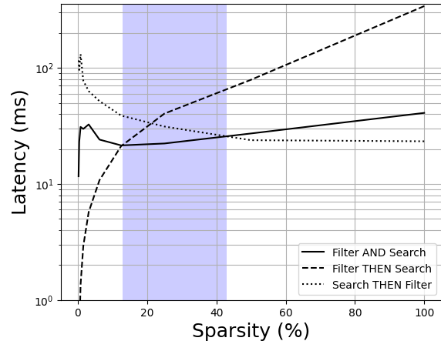
Filter and Search
Real scenario:
Constraints are neither sparse nor very dense
The unhappy middle
MNIST
Filter AND Search
Embedding
Results
Constraints
0 1 0 1 1 0 1 0 1 1 1 1 0 1 0
Embedding based Partitions
Items

Slide 11
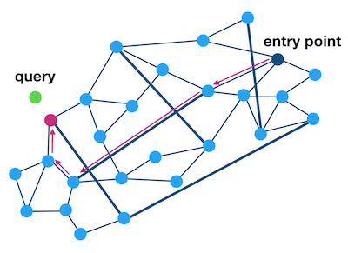

Existing approaches
Real scenario
The unhappy middle
Exiting filter-and-search methods are graph-based and they suffer from constraint sparsity
1
1
1
1
1
1
1
1
1
Constraints
0 1 0 1 1 0 1 0 1 1 1 1 0 1 0
Embedding based Partitions

Slide 12
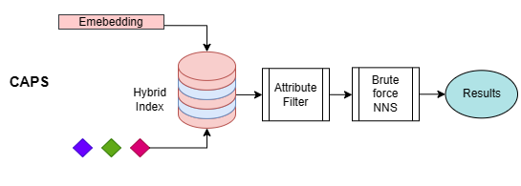
CAPS: Constrained Approximate Partition Search
We propose CAPS: Constrained Approximate Partition Search
Hybrid Index: filter-and-search
Works with any near-neighbor partitioning
Beats SOTA constrained near neighbor search.
Constraints
0 1 0 1 1 0 1 0 1 1 1 1 0 1 0
Embedding based Partitions

Slide 13
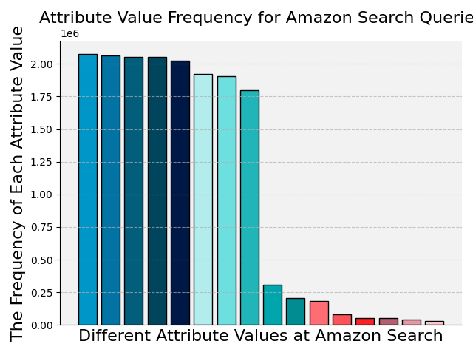
CAPS: Constrained Approximate Partition Search
Embedding based Partitioning
Query
Vector
Bucket 1
Bucket 2
Bucket m
Bucket B
ANN function
Query
attributes
Attribute
router
Price <$100
Overnight delivery
Attribute based
Partitioning
Size: Medium
Rest
Huffman
tree

Slide 14
CAPS: Constrained Approximate Partition Search
Query time -> Query time /S S: number of subpartitions
Embedding based Partitioning
Query
Vector
Bucket 1
Bucket 2
Bucket m
Bucket B
ANN function
Query
attributes
Attribute
router
Attribute
router
Attribute
router
Attribute
router
Price <$100
Color: Blue
Overnight delivery
Attribute based
Partitioning
Size: Medium
Rest
Overnight
delivery
Huffman
tree

Slide 15
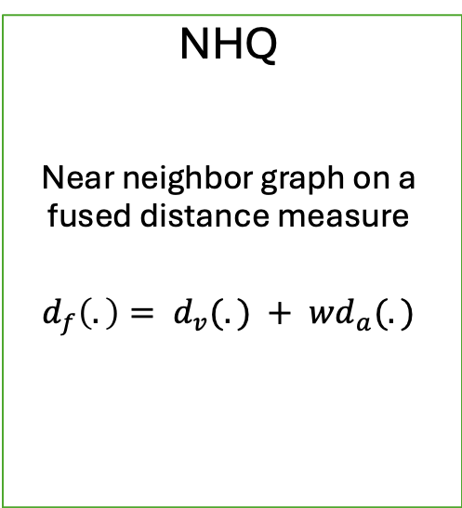
Experiments: Baseline
NHQ
Near neighbor graph on a fused distance measure
$$d_{f}\left(.\right)= d_{v}(.) + wd_{a}(.)$$
AIRSHIP
Near neighbor graph with beam search buffer containing constraint satisfied neighbors
DiskANN
Near neighbor graph based two variations
Filtered DiskANN
Stiched DiskANN

Slide 16
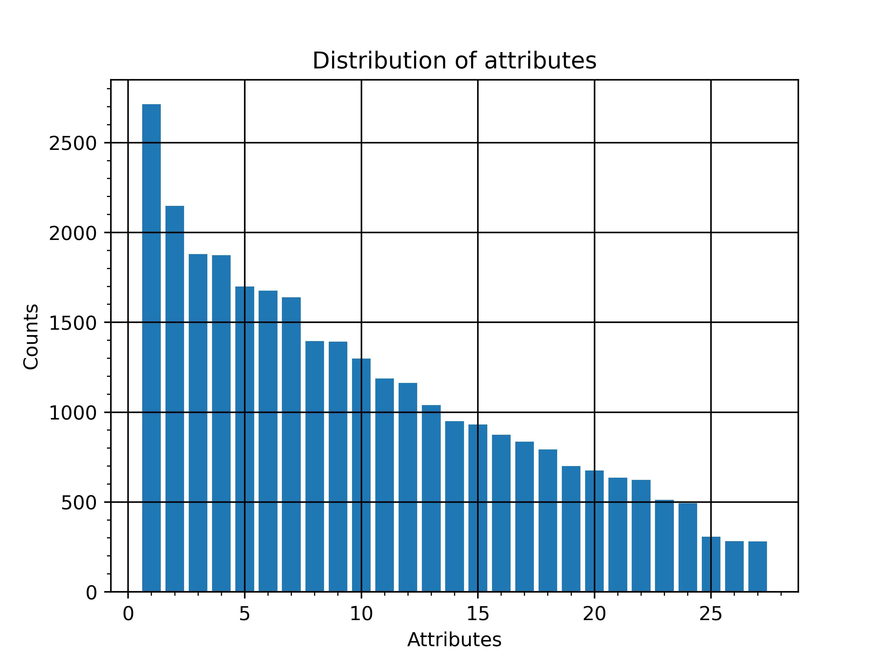
Experiments: Dataset
Data Corpus Dim # Attribute types #Unique attributes
SIFT 1M 128 3 27
Glove 1.18M 100 3 27
Crawl 2M 300 3 27
Msong 992K 420 3 27

Slide 17
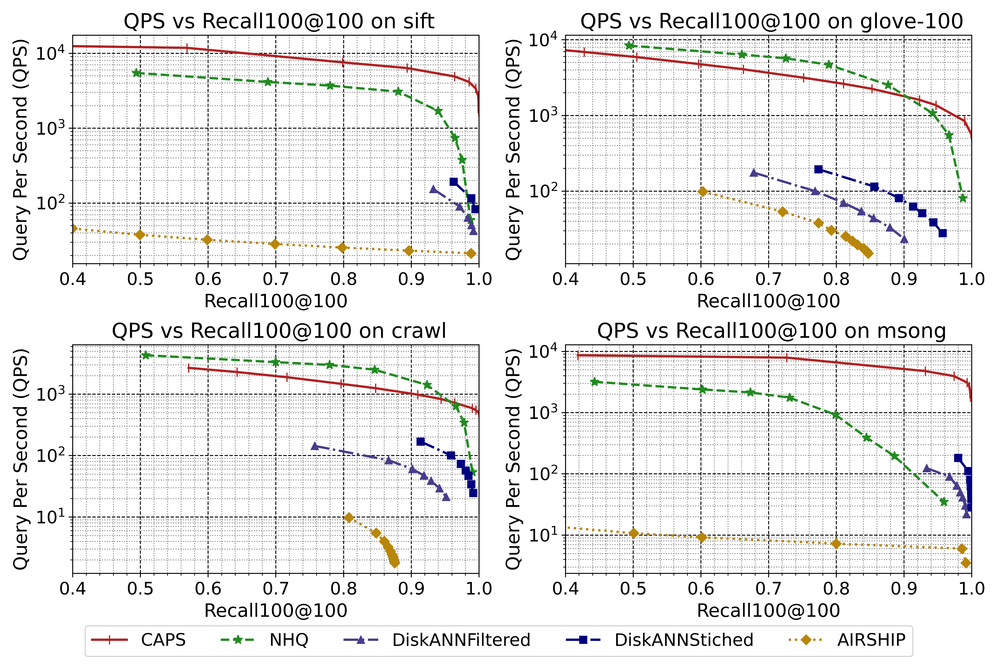
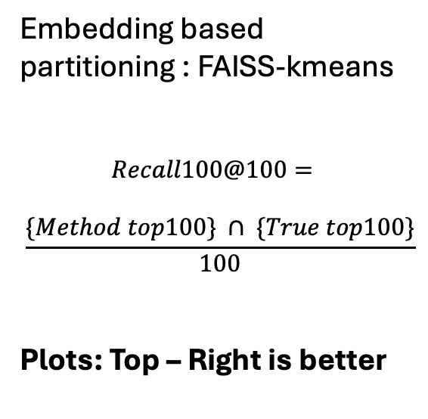
Experiments: Recall vs QPS
Embedding based partitioning : FAISS-kmeans
$$Recall100@100=$$
$$\frac{\{Method top100\} ∩ \{True top100\}}{100}$$
Plots: Top – Right is better

Slide 18
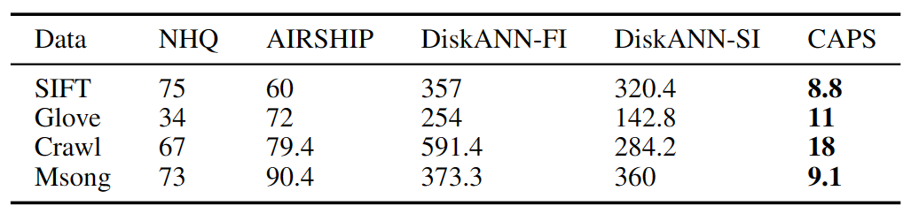
Experiments: Index size
Table shows the index size overhead
Lower is better
Index size (MB) of CAPS against the baselines

Slide 19
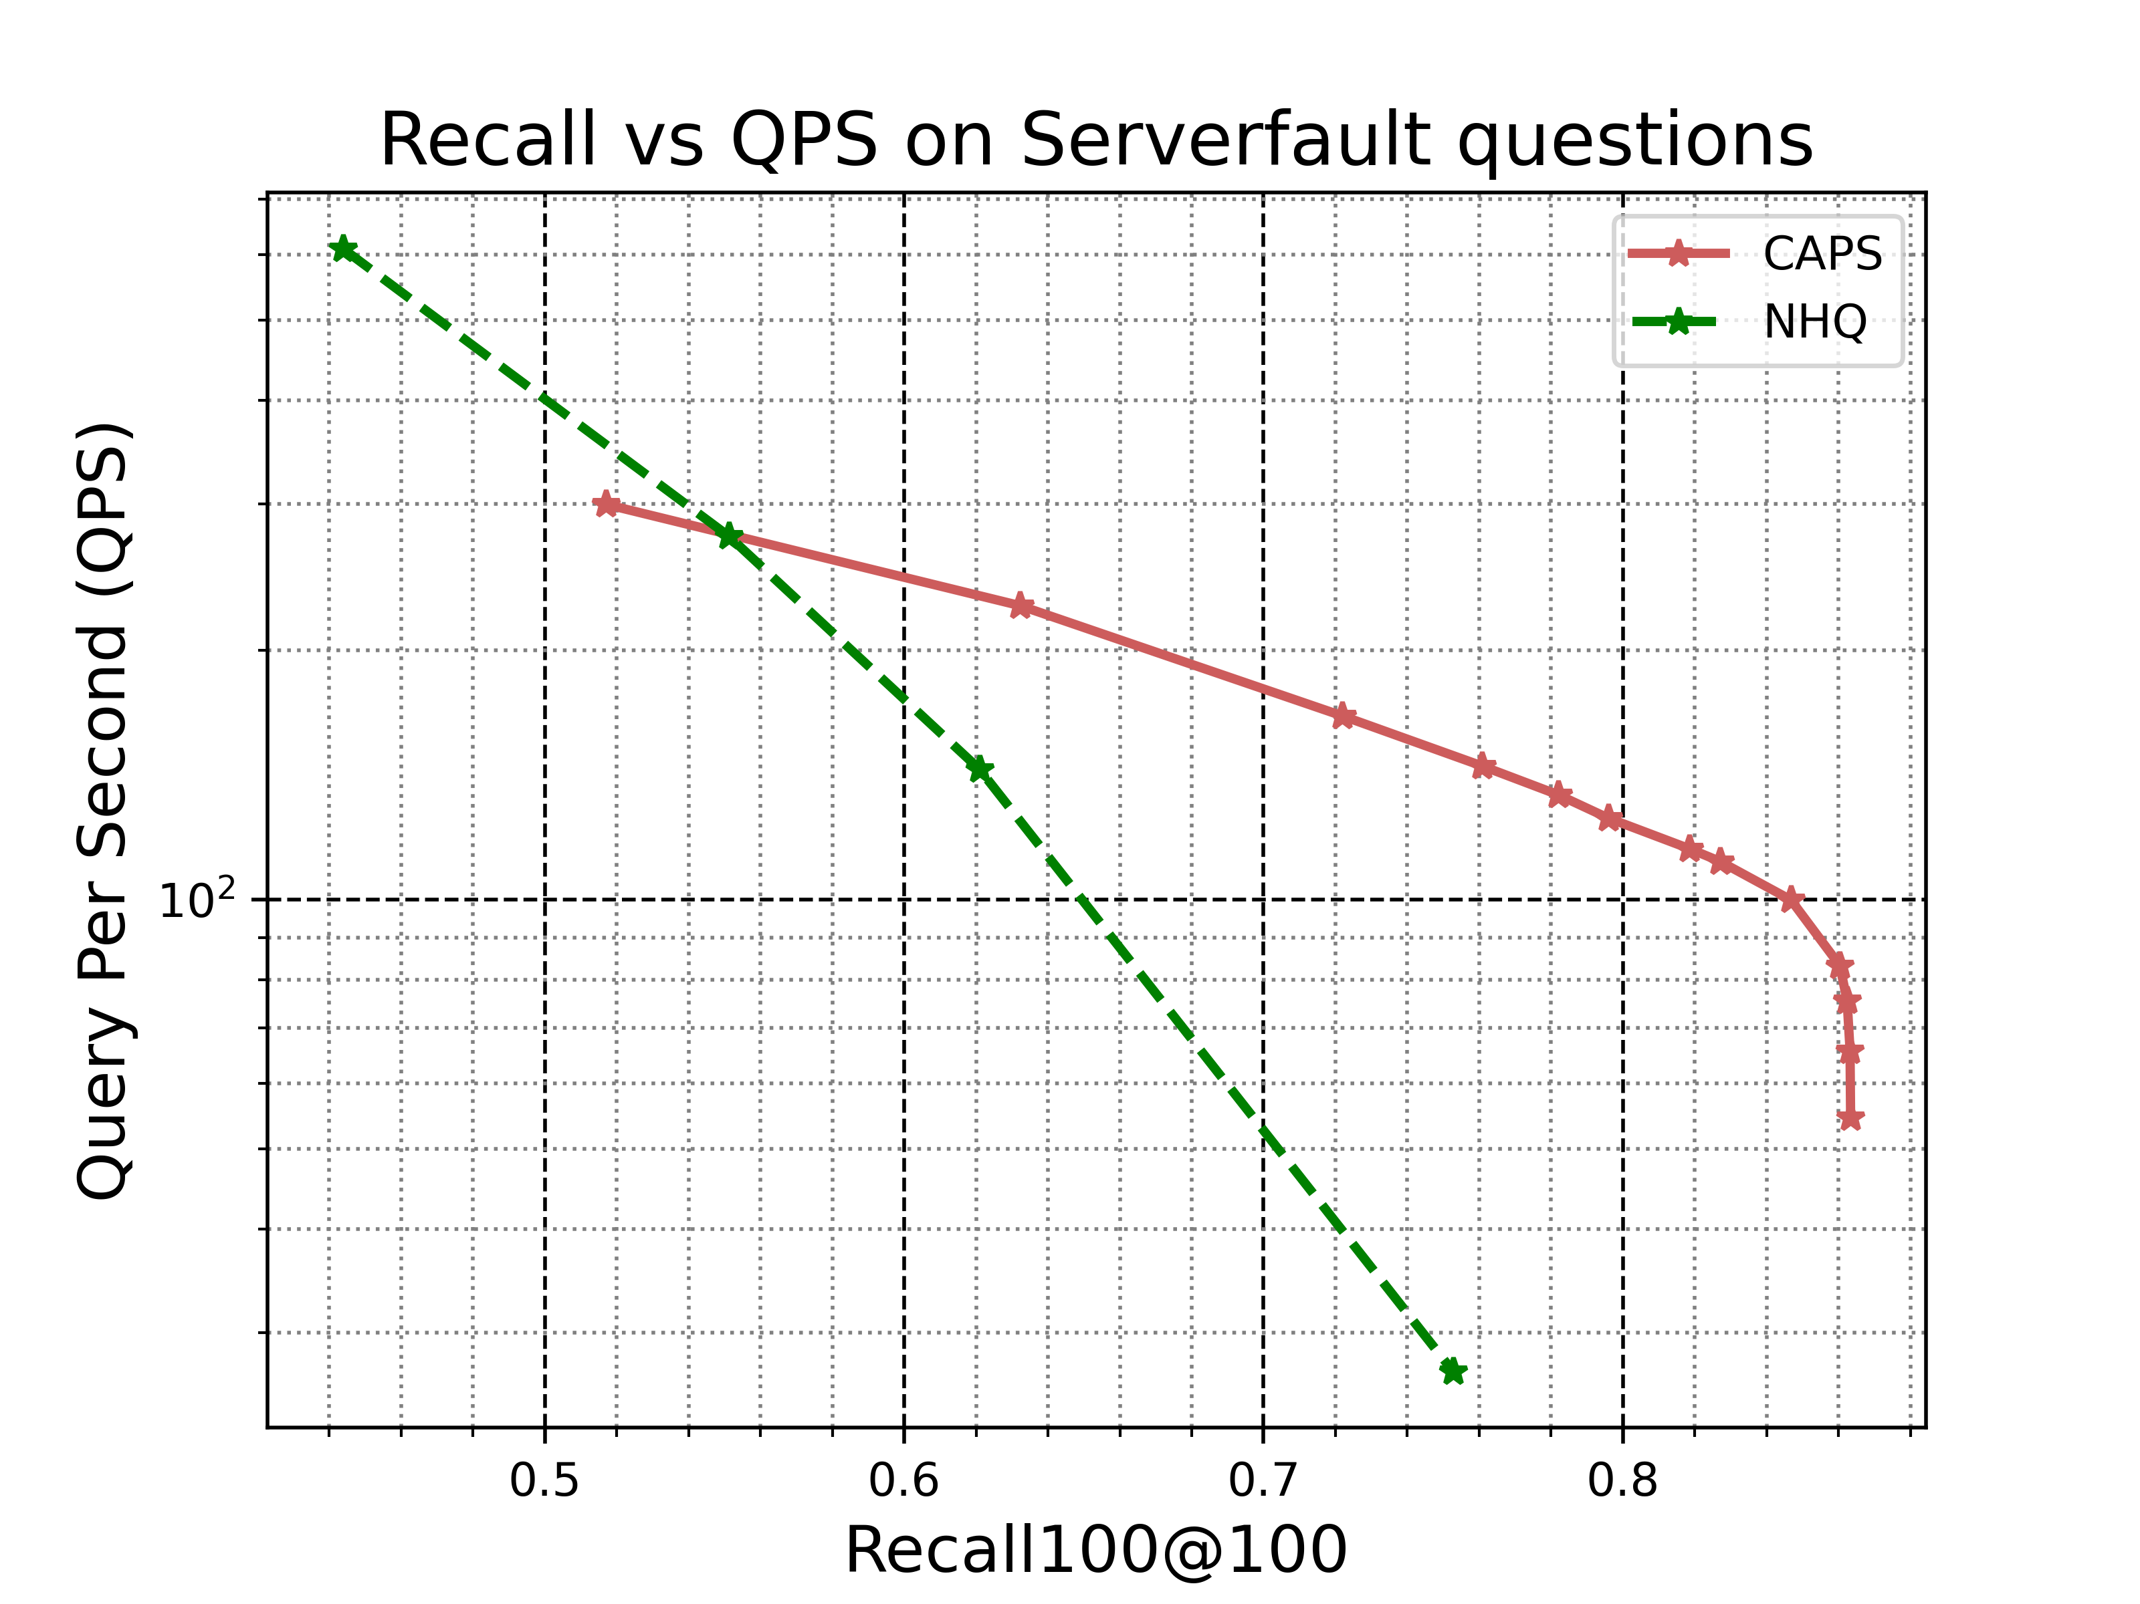
Performance analysis on real-world attributes data
Stackexchange questions: Serverfault
832692 questions
sentence-transformers, multi-qa-mpnet-base-dot-
v1 embedding of size 768
Our nightly full (and periodic differential) backups are becoming quite large, due mostly to the amount of indexes on our tables; roughly half the backup size is comprised of indexes. We're using the Simple recovery model for our backups. Is there any way through using FileGroups or some other file-partitioning method to exclude indexes from the backups? It would be nice if this could be extended to full-text catalogs as well.
Tags: sql-server, backup, sql-server-2008, indexes
Embedding
Attributes

Slide 20
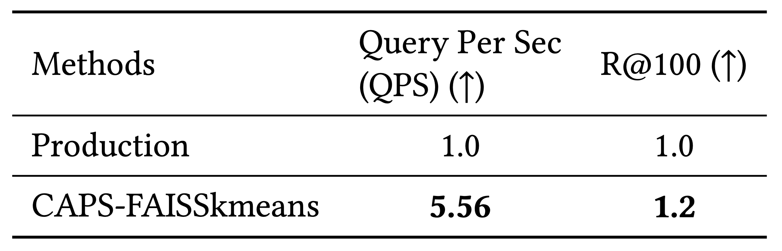
Performance analysis on real-world attributes data
Amazon: query autocompletion with constraints
8M search phrases represented by
embedding of dim = 768
#unique attributes = 11

Slide 21
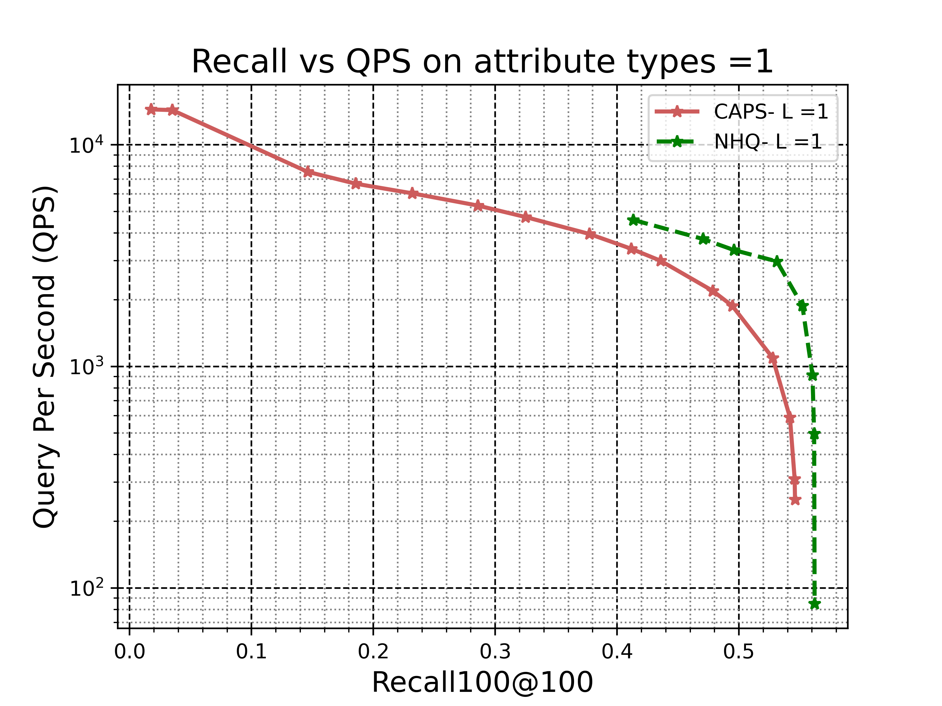
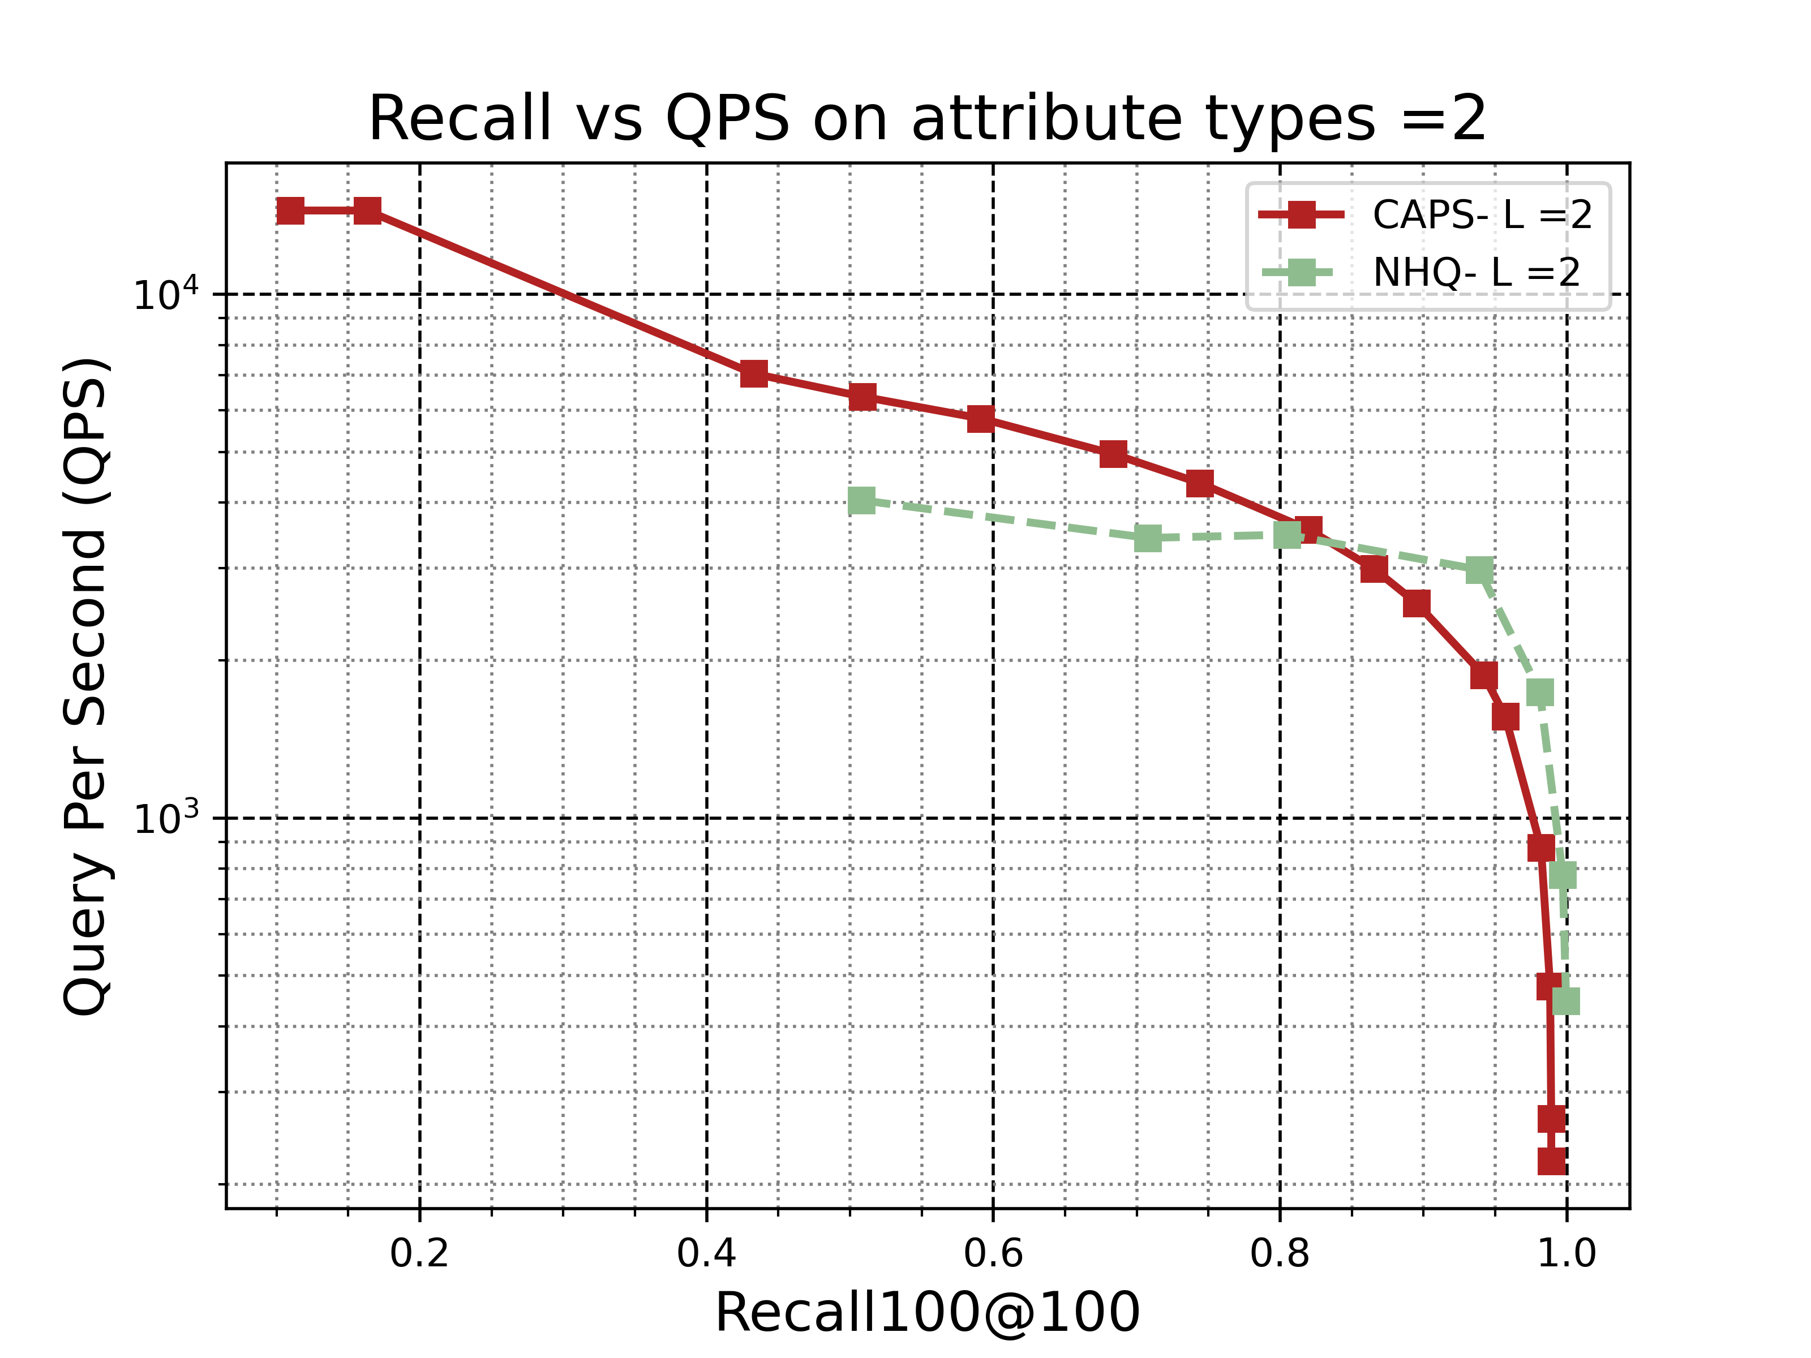
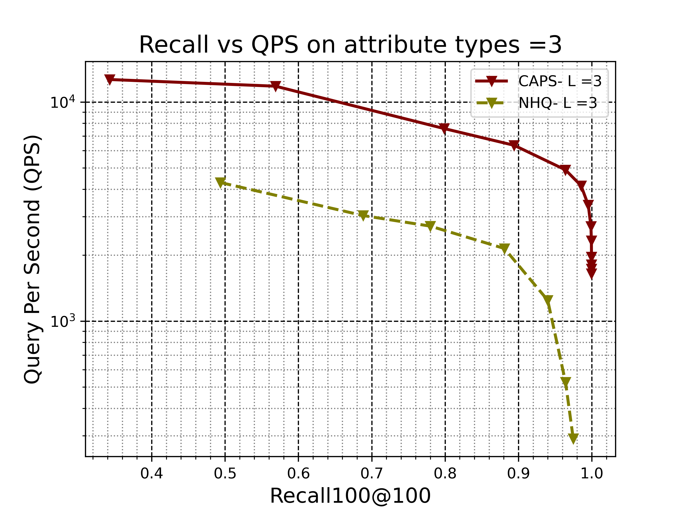
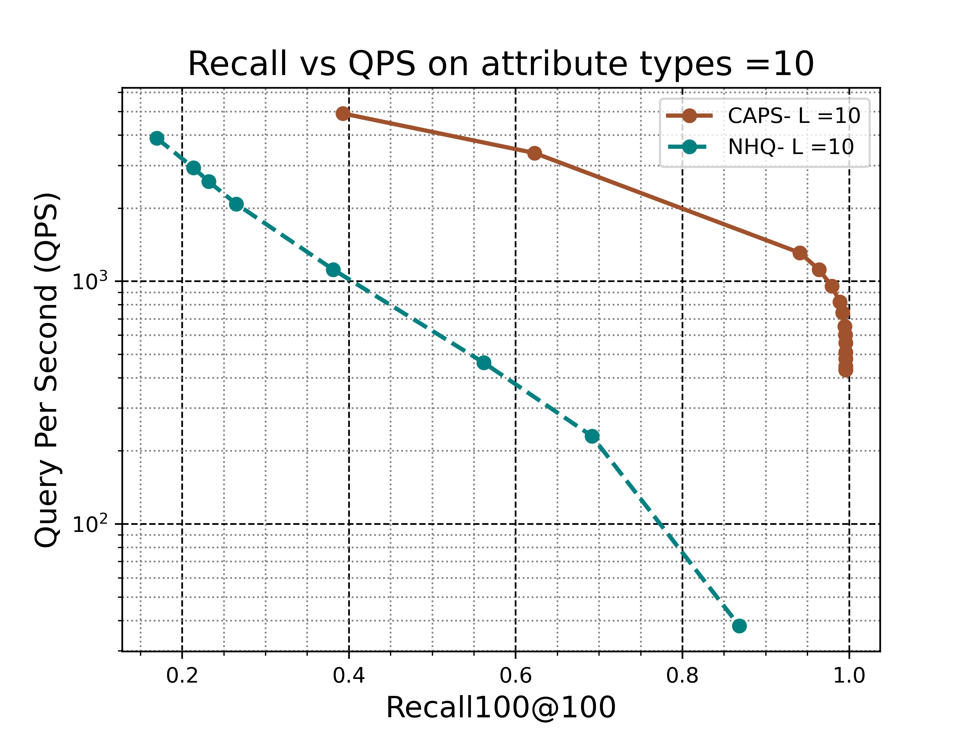
Varying # of attributes (L)
For 1 attribute, NHQ is about 13% better than CAPS
For 2 attributes, NHQ is about the same as CAPS
For 3 attributes, CAPS is about 40% better than NHQ
For 10 attributes, CAPS is significantly better than NHQ (About 300%)

Slide 22
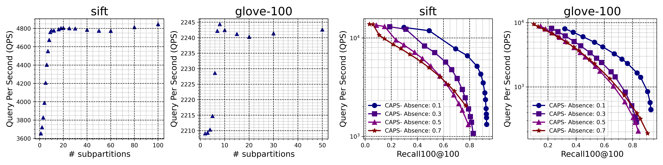
Ablation study
Absence of attributes in query
Absence = fraction of missing attributes in query
Higher absence = High attribute sparsity

Slide 23
Ablation study
Attribute partitioning tree height
Varying number of subpartitions.
Each subpartitions is a disjoint group of items, identified by an attribute
Latency reduces with subpartition size.

Slide 24
Summing up
CAPS/Overall: Partitioning-based large-scale retrieval system
Have a competitive QPS-recall tradeoff
Favors lower memory footprint
Support variability in query attributes
Favors mid-large # of attributes
Better scalability

Slide 25
Limitations and future work
Extreme ends of attribute sparsity
  search-then-filter and filter-then-search will be optimal
Range based attributes
  can be quantized to categories
Negation filters
  finding items constrained on absence of an attribute.

Slide 26

Thank you
Contact :
Gaurav Gupta, gguptmz@amazon.com
Code is available at
https://github.com/gaurav16gupta/constrainedann

